Slide 1
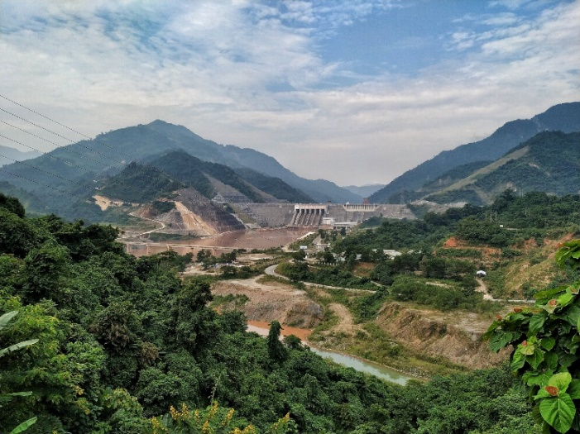
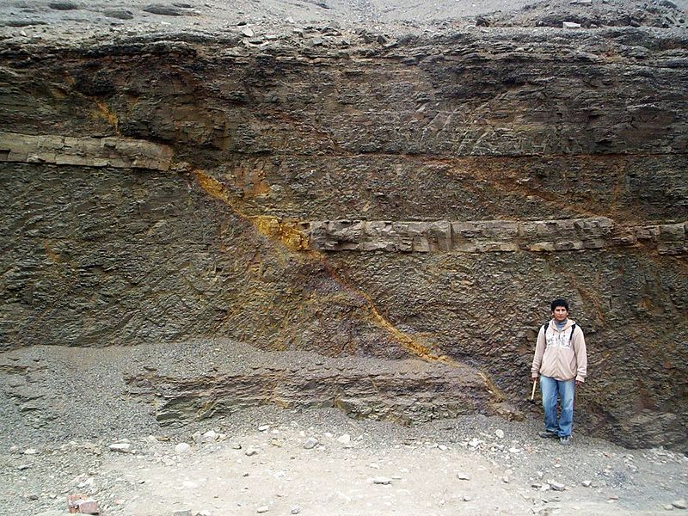
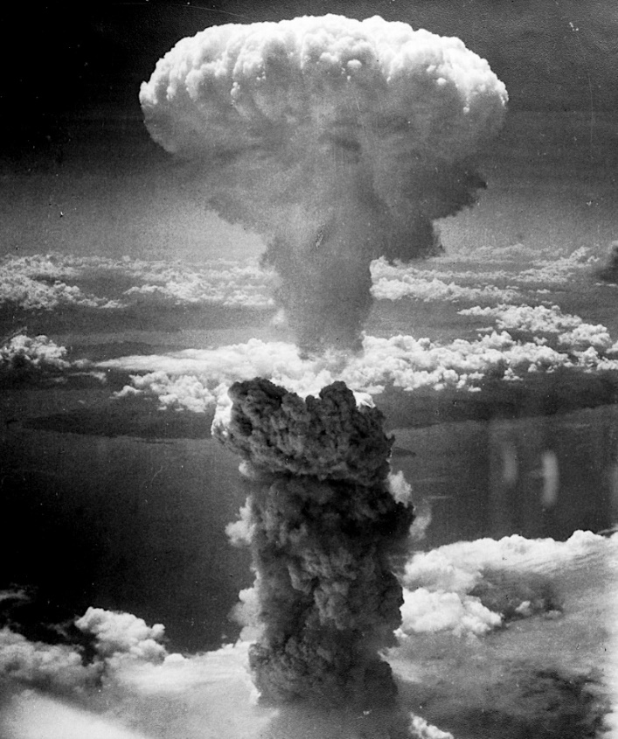
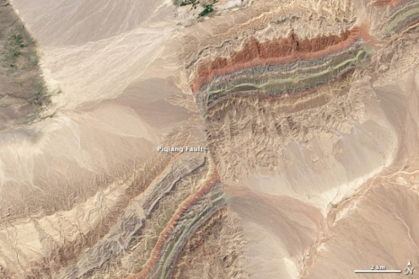
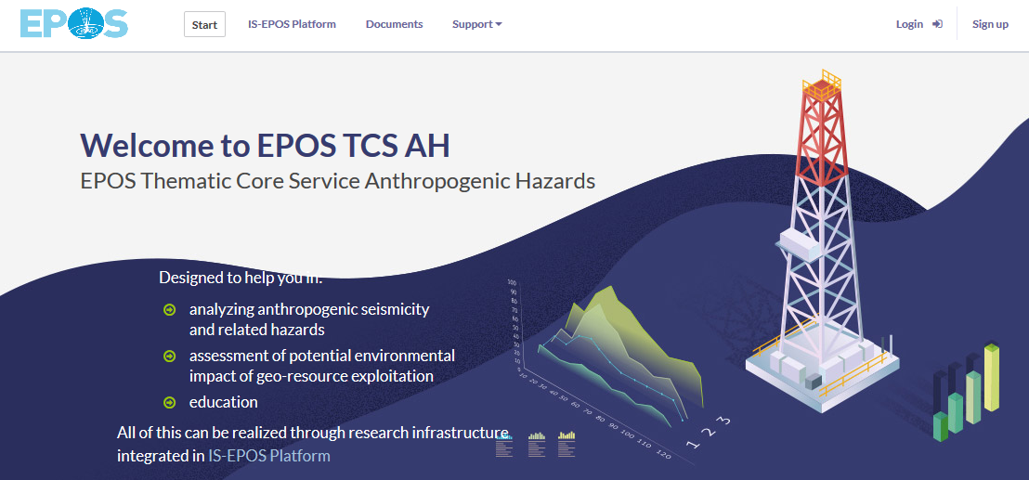
Should location of new important infrastructure and human habitats be allowed in the area of anthropogenic seismic hazard?
Photo: G. Lizurek
Photo: Miguel Vera León, Wikimedia Commons
Photo: Library of Congress
Photo: NASA Earth Observatory images by Robert Simmon and Jesse Allen, using Landsat data from the USGS Earth Explorer

Slide 2
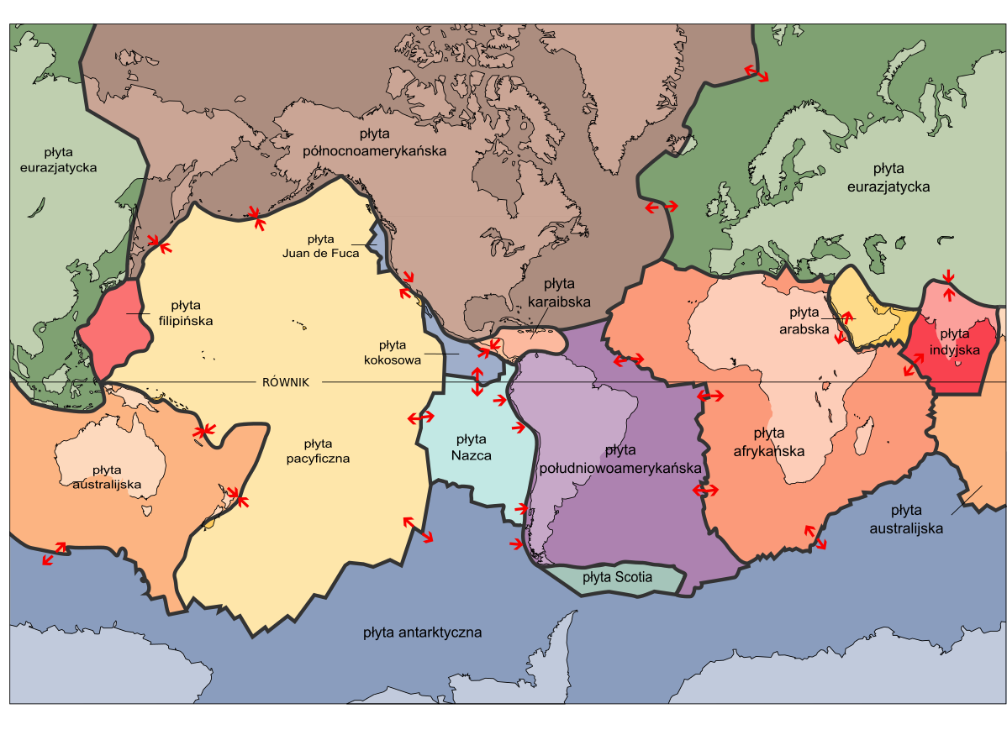
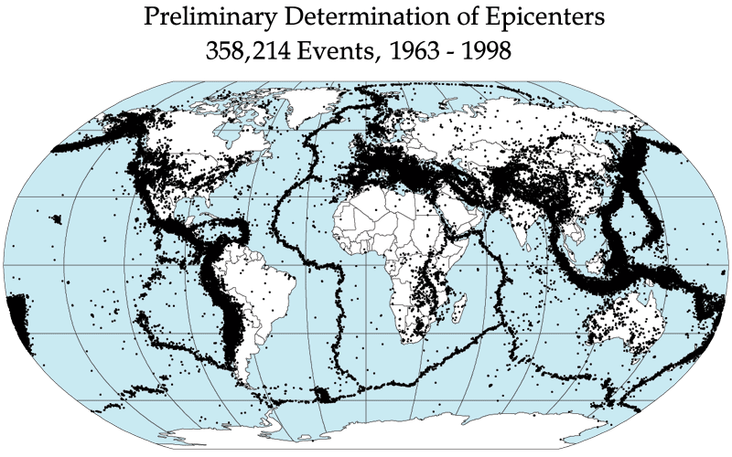
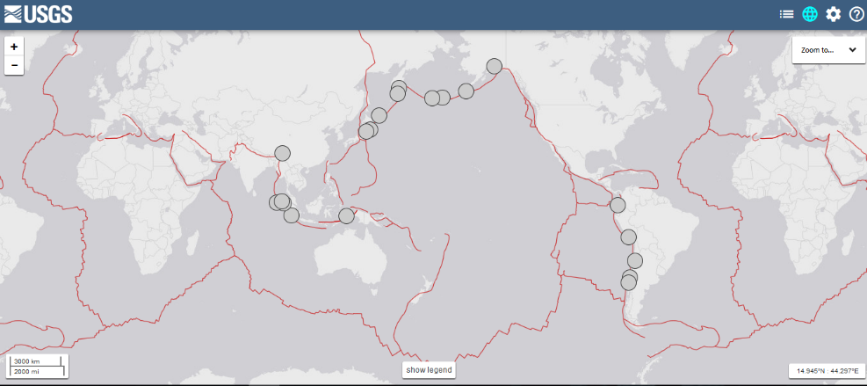
Tectonic earthquakes
By Adi4000 - Praca własna, Domena publiczna, https://commons.wikimedia.org/w/index.php?curid=5116342

Slide 3
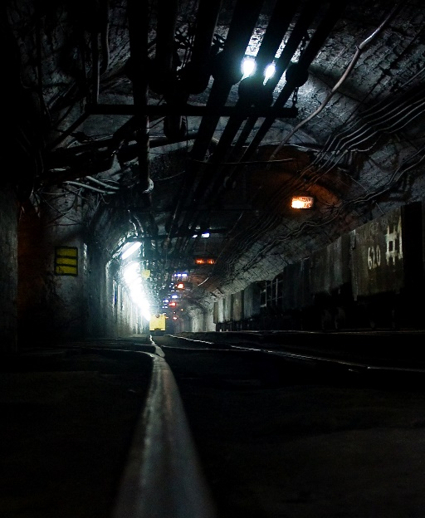
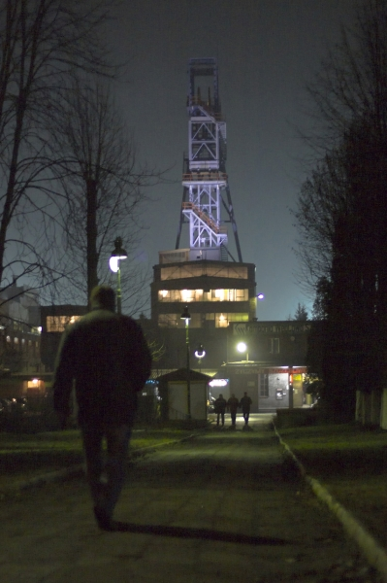
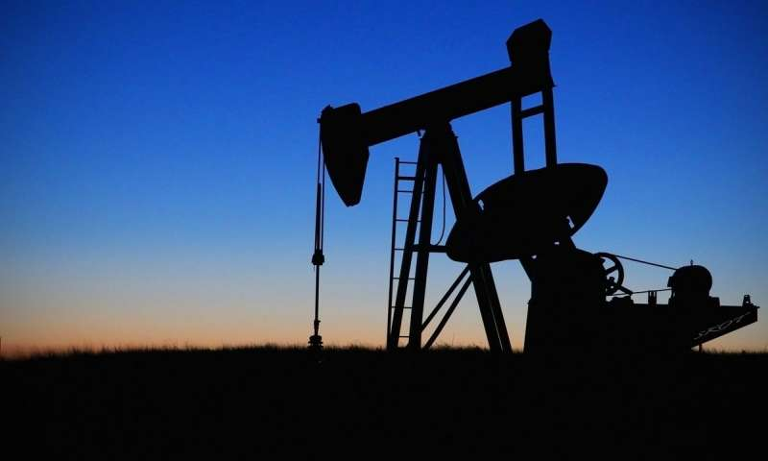
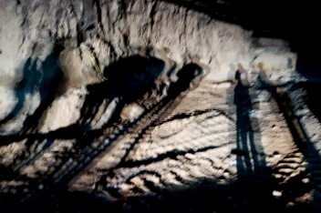
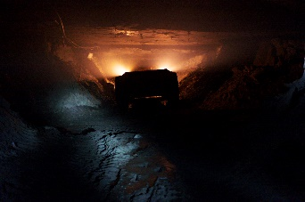
Anthropogenic seismicity
Man made earthquakes induced or triggered during georesources exploitation, water reservoir impoundment or bomb blasts etc.
https://inducedearthquakes.org/
https://commons.wikimedia.org/wiki/File:Kopalnia_w%C4%99gla_brunatnego_i_elektrownia_w_Be%C5%82chatowie.jpg

Slide 4
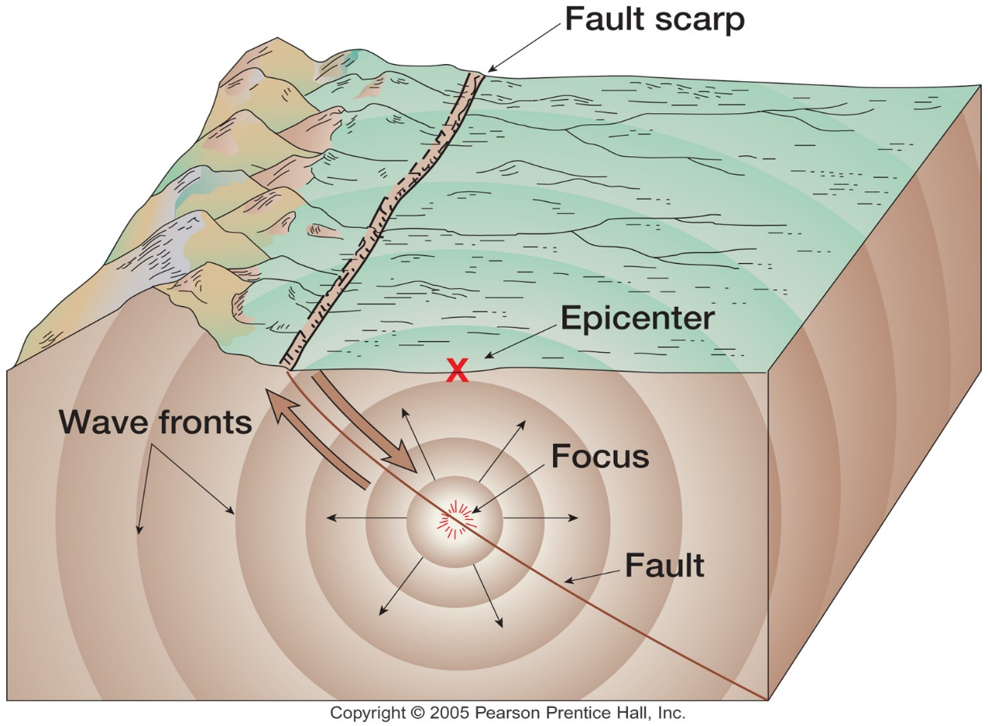
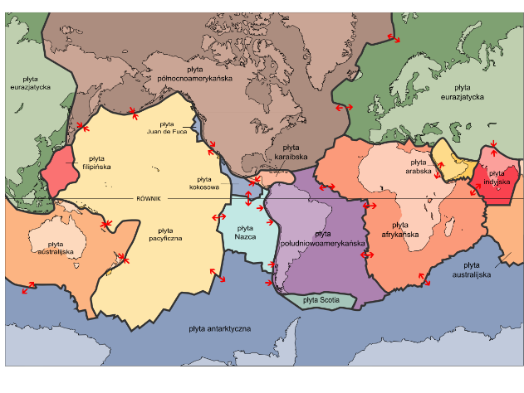
Tectonic earthquakes
By Adi4000 - Praca własna, Domena publiczna, https://commons.wikimedia.org/w/index.php?curid=5116342

Slide 5
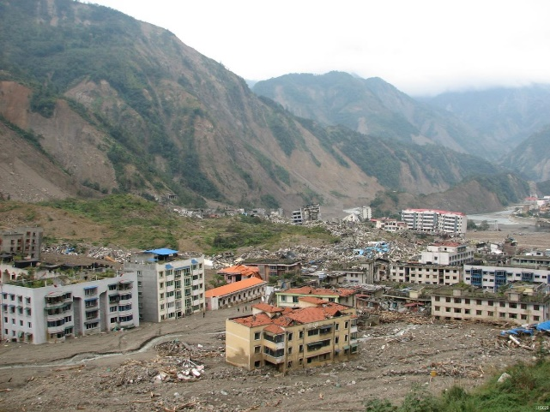
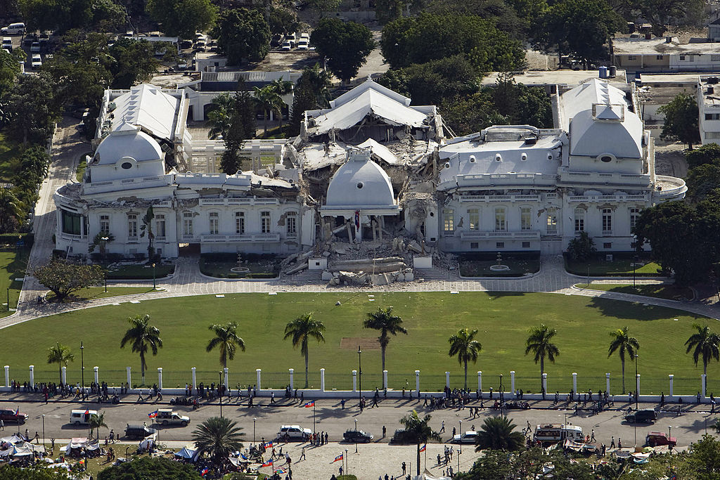
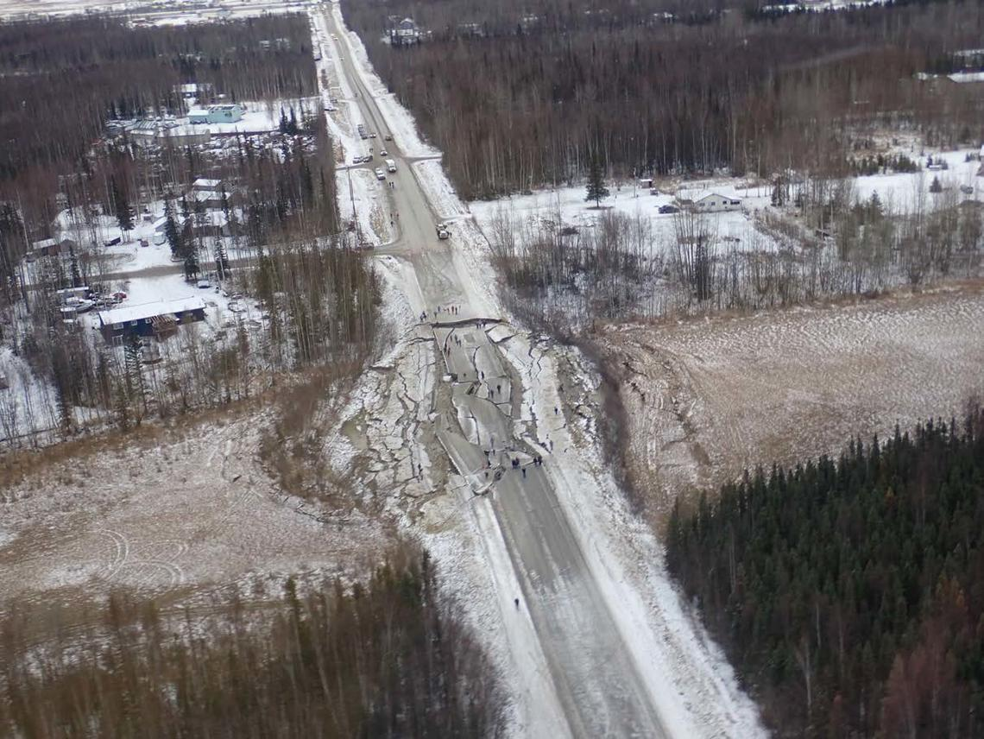
Earthquakes are the most tragic natural disasters:
Sumatra 2004 M9.1 earthquake and tsunami with waves up to 30 m height caused 280 000 casualties and material loss of about 15 billions USD
Japan 2011 M9.1 earthquake and tsunami caused 20 000 casualties and material loss of about 235 billions USD
Haiti 2010 M7 earthquake caused 200 000 casualties and almost complete breakdown of the state
Photo: David Wald, USGS. Public domain
https://www.usgs.gov/media/images/damage-2008-great-sichuan-earthquake-china
Photo: Logan Abassi/UNDP Global
https://commons.wikimedia.org/wiki/File:Haitian_national_palace_earthquake.jpg
Photo: Rob Witter/USGS
https://www.usgs.gov/news/2018-anchorage-earthquake

Slide 6
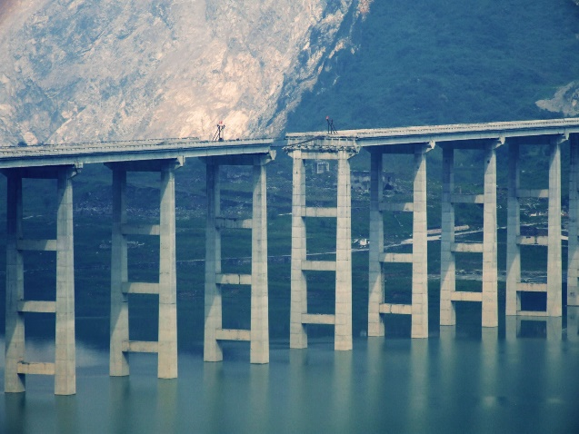
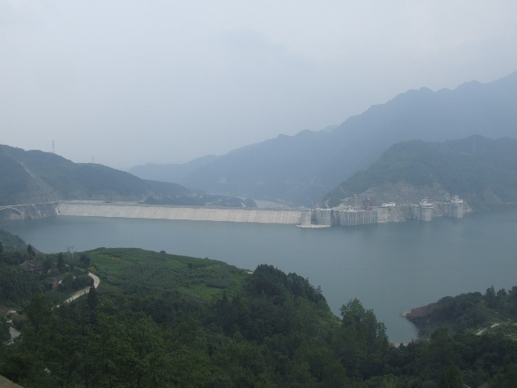
Examples of anthropogenic seismic events:
Zipingpu (China) M7.9, 2008, most likely triggered on active fault by water reservoir impoundment, caused 88 000 casualties and material loss of about 150 billions USD
Gazli (Uzbekistan) M7.3, 1976, operations related to natural gas exploitation and storage caused earthquake, 100 injured, one casualty, large damage of infrastructure in Gazli
Koyna (India) M6.3, 1967, earthquake triggered by water reservoir impoundment, caused 200 casualties, several thousands injured and material loss of about 400 000 USD
Photo: David Wald, USGS. Public domain
https://www.usgs.gov/media/images/damage-2008-great-sichuan-earthquake-china
https://upload.wikimedia.org/wikipedia/commons/3/3d/Miaoziping_Bridge_damaged_in_2008_earthquake.jpg
https://upload.wikimedia.org/wikipedia/commons/0/09/Zipingpu_Dam.JPG
https://inducedearthquakes.org/

Slide 7
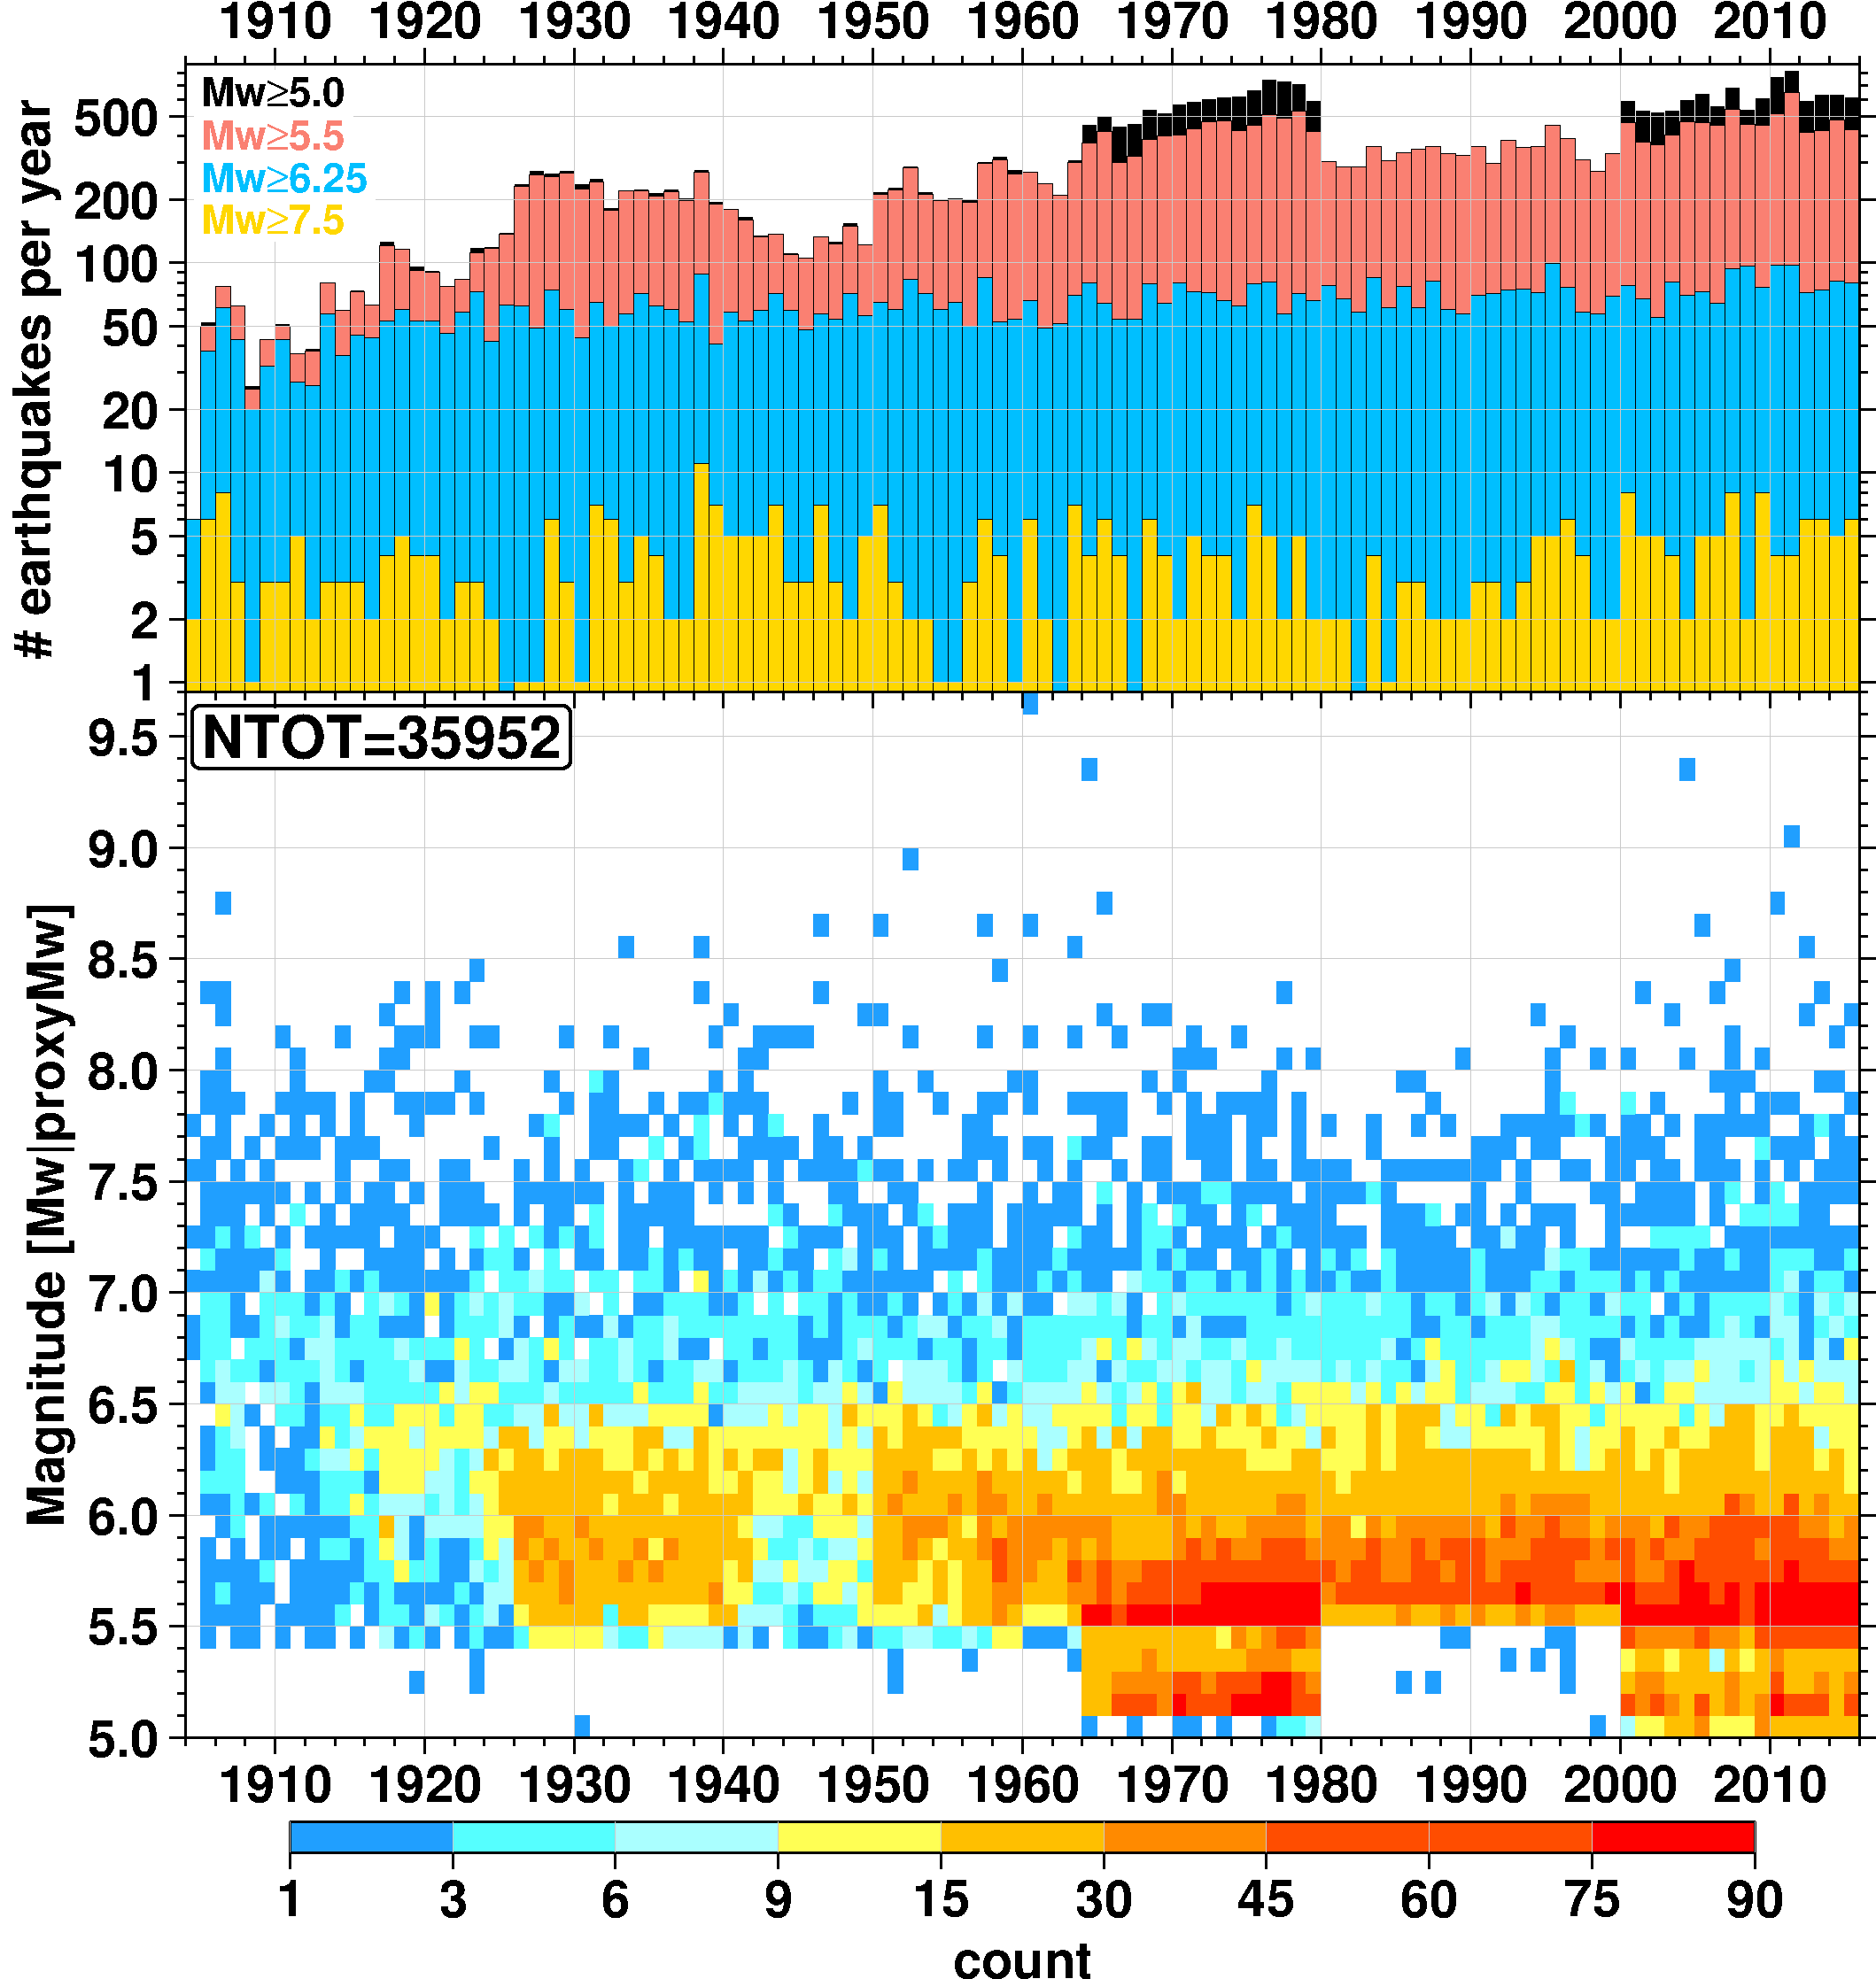
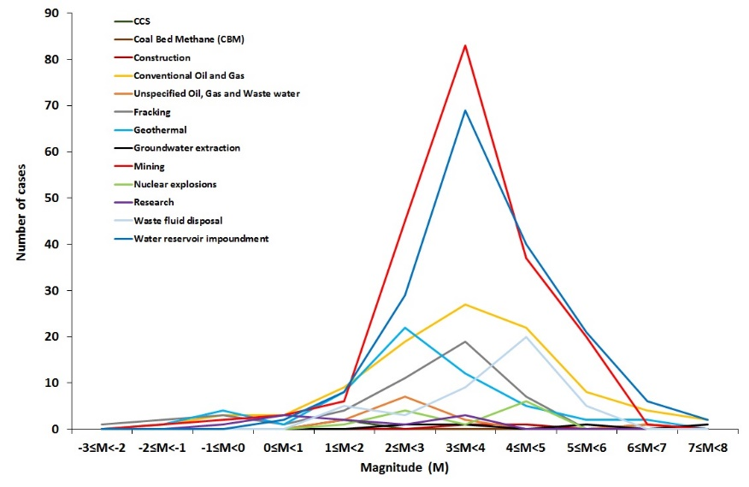
Tectonic vs anthropogenic seismicity
Tectonic:
Several hundreds of earthquakes with M>5 per year. Maximum several events with casualties annually.
Anthropogenic:
All known anthropogenic seismic events with M>5 were less than 10. Large and tragic events with casualties were several within last hundred years.
https://inducedearthquakes.org/

Slide 8
Should location of new important infrastructure and human habitats be allowed in the area of anthropogenic seismic hazard?
Photo: G. Lizurek
Photo: Miguel Vera León, Wikimedia Commons
Photo: Library of Congress
Photo: NASA Earth Observatory images by Robert Simmon and Jesse Allen, using Landsat data from the USGS Earth Explorer

