Slide 1
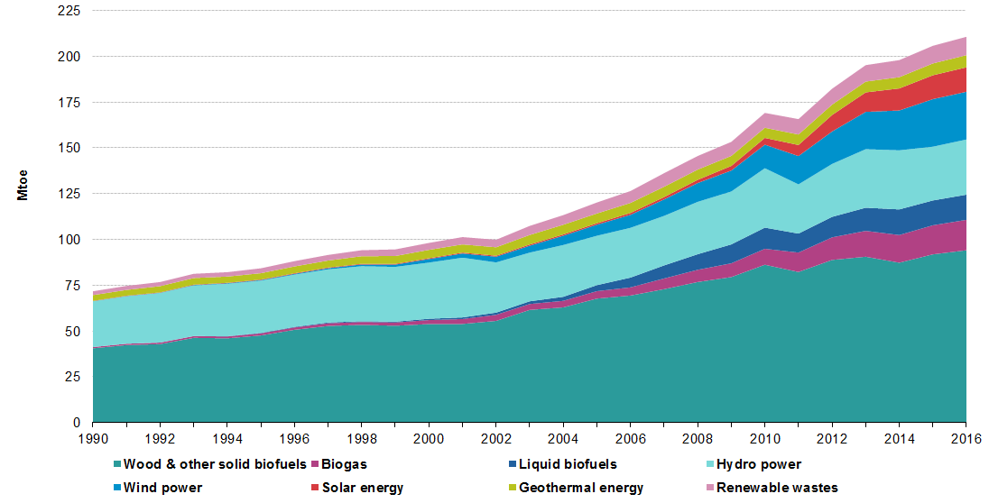
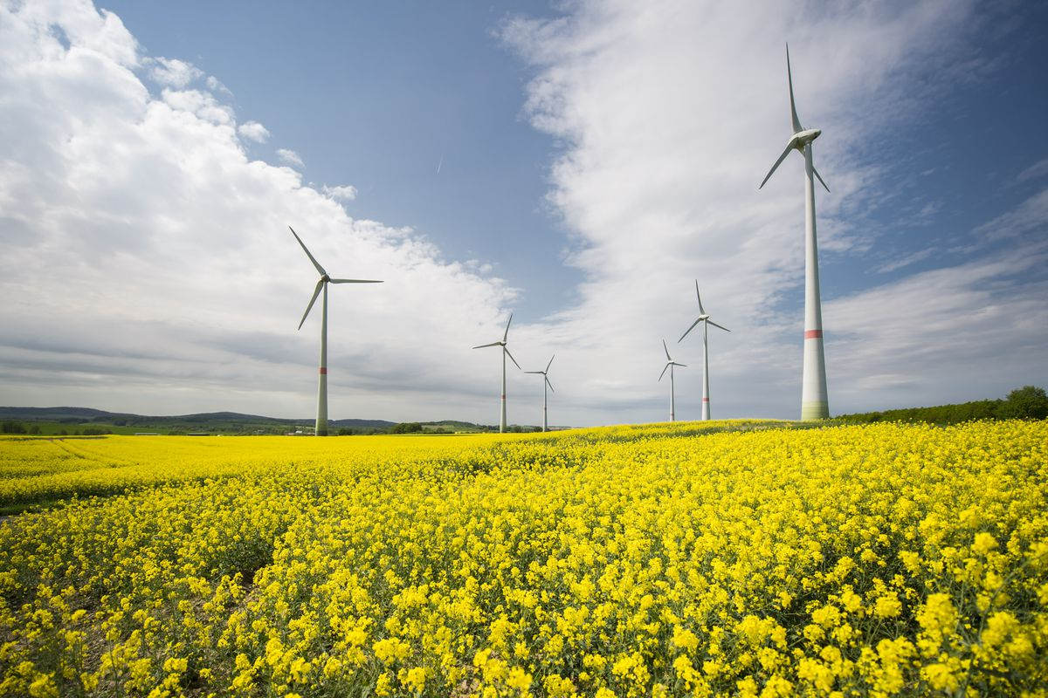
Wind energy–should we invest more?
Sun
Wind
Hydro
Bio
Fig 1: Energy consumption from renewable energy sources, EU-28, 1990-2016. Source: Eurostat

Slide 2
Renawable sources – real costs
Creation and installation
Maintenance
Environmental influence
Social impact
Lifespan
Recycling

Slide 3
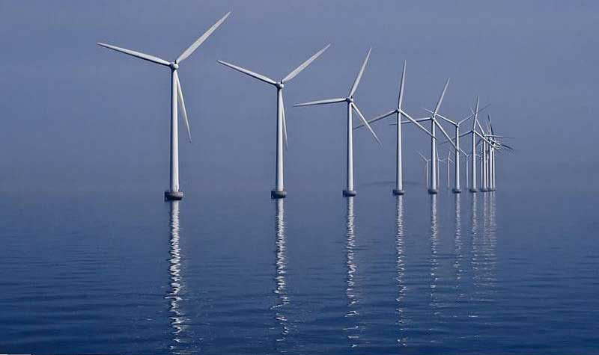
Renewable sources - real costs
Wind energy
cheap and abundant materials – steel, aluminium, glass fibre, copper
costly, dangerous and time-consuming maintenance
short lifespan
large requirement for space per 1MW
relatively easy recycling
Fig 2: Wind farm, Copenhagen

Slide 4
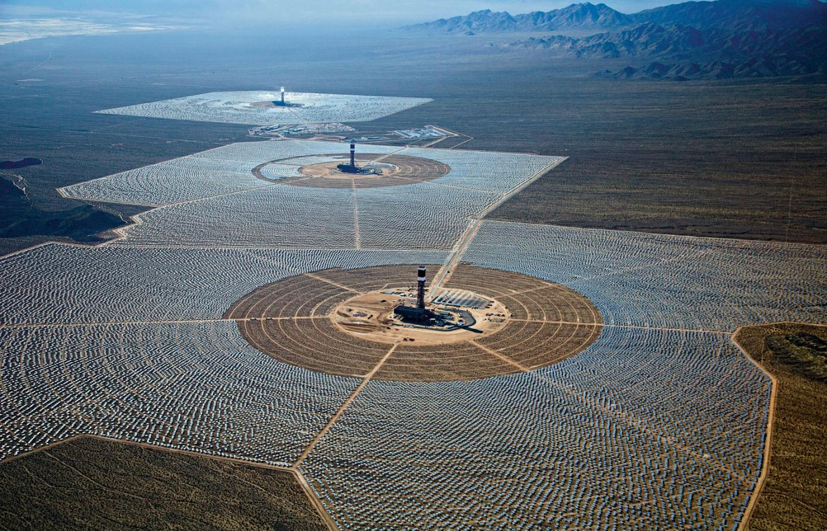
Renewable sources - real costs
Solar energy
Photovoltaics
expensive and scarce materials – rare-earth elements
relatively expensive maintenance
moderate space requirements
influence on local albedo
expensive recycling
How about solar collectors?
vary low efficiency in diffused light conditions (thin clouds and aerosols)
Fig 3: Solar thermal collector power plant, California

Slide 5
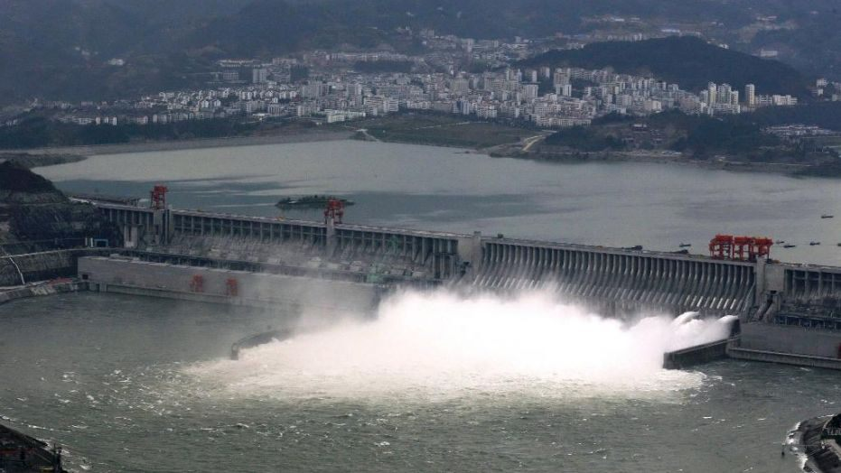
Renewable sources - real costs
Hydropower
large installations – cheap materials
significant social and environmental influence
relatively cheap maintenance
very long lifespan
high and difficult to estimate recycling costs
Fig 4: Three Gorges Dam, China

Slide 6
Wind energy – pros and cons
How much kinetic Energy is stored in the atmosphere?
$P=\frac{E_{k}}{t}=\frac{m(t) v^{2}}{2t} m\left(t\right)=ρV=$ $ρSvt P=\frac{ρS v^{3}}{2}$
The amount of commercially available wind power exceeds the current needs of humanity twentyfold

Slide 7
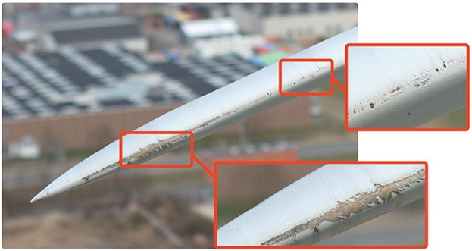
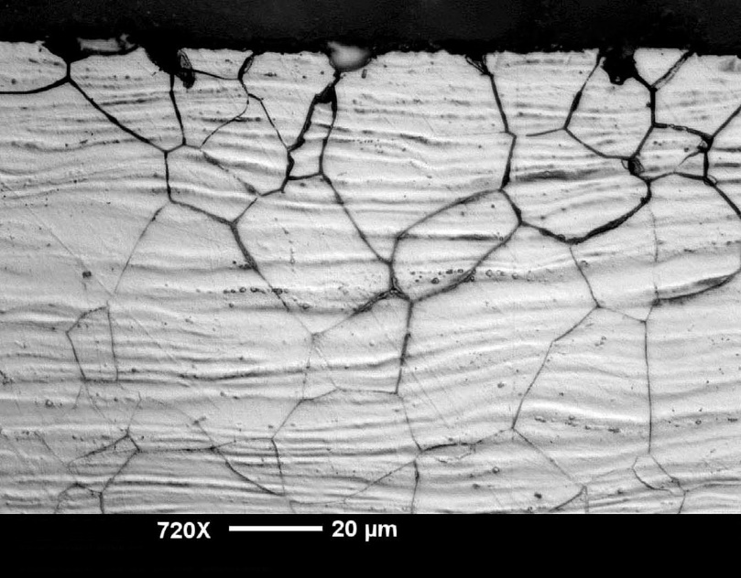
Wind energy – pros and cons
Lifespan
wing erosion
salty working conditions - aluminium inter-granular corrosion
Fig 5: Wing erosion – top aluminium inter-granular corrosion – left

Slide 8
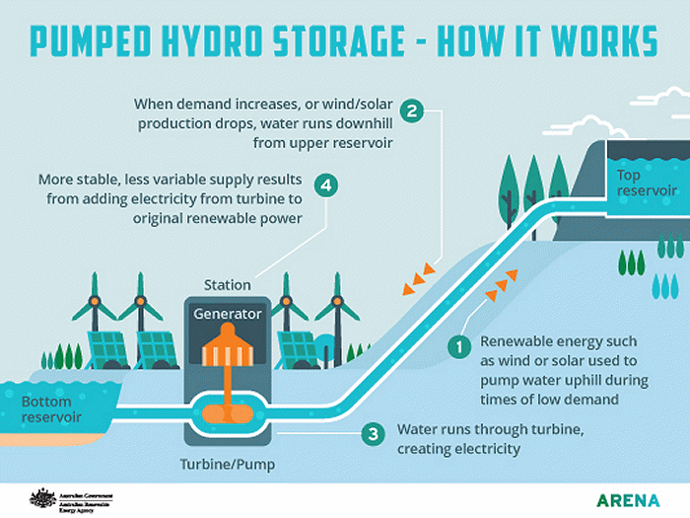
Wind energy – pros and cons
Energy storage
difficulties in near-real-time wind speed forecasting
chemical Energy accumulators
supercondensators
pumped hydro storage
Fig 6: Pumped hydro storage

Slide 9
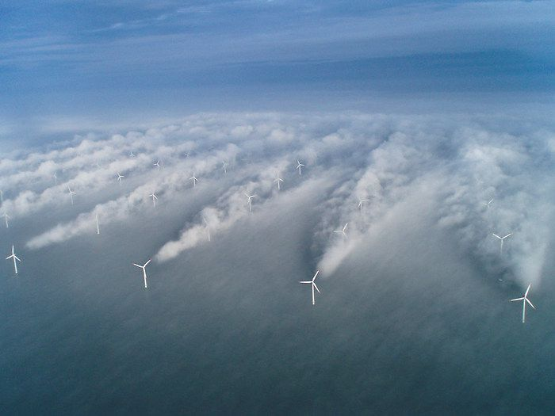
Wind energy – pros and cons
Influence on local precipitation pattern
rotating wind turbine – turbulence
cloud formation – 100% of relative humidity is not enough
precipitation shadow
planetary albedo
Fig 7: Turbulence based cloud generation

Slide 10
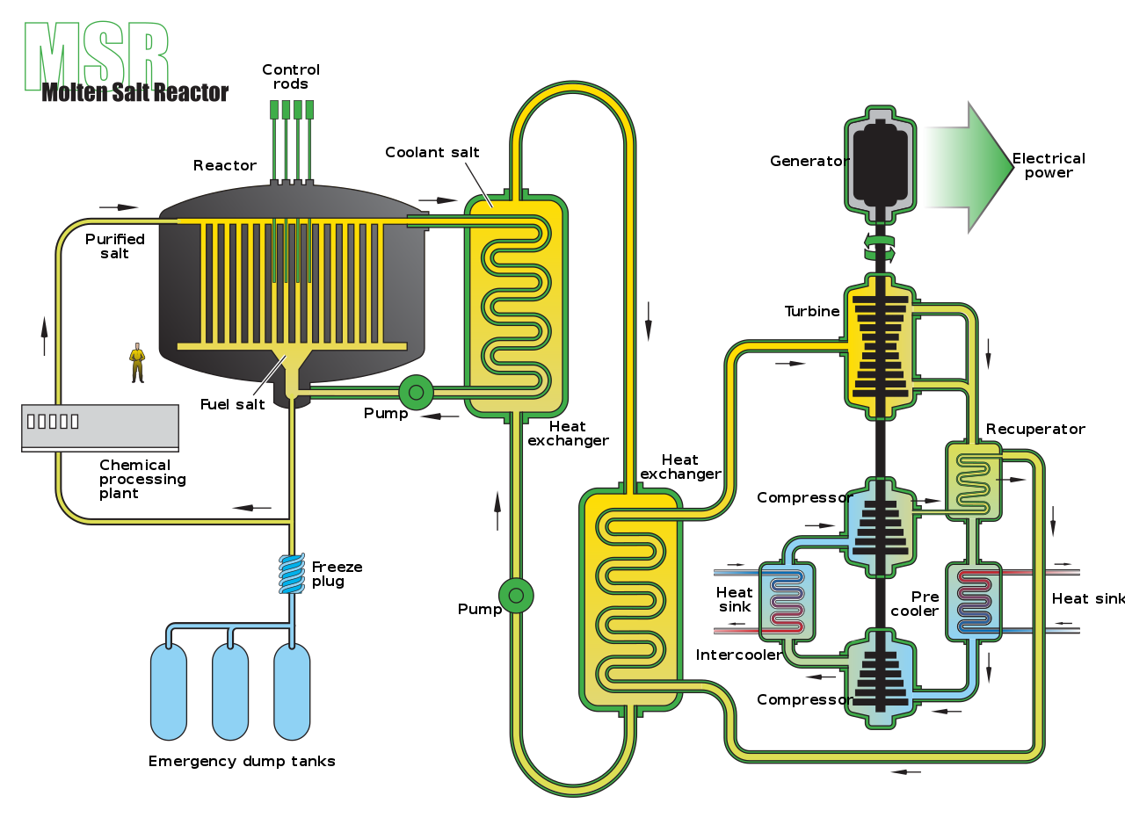
What about nuclear?
Safety
Real costs
Waste
Proliferation of nuclear weapons
New technologies
Fig 7: A schematic of a MSR type nuclear installation that utilizes liquid fuel design

