Slide 1
Nanotechnology Health and Environment
2
Dimitrios I. Sotiropoulos, Member of Η.Ι.R.C.S.,
Physicist, M.E.d. in Science Teaching
Ph.D. in Education in Science and Digital Technology
6, February 2020
Online Webinar
Notes:
Γενική Θεματική

Slide 2
Initiation
1
https://www.youtube.com/watch?v=CjpXj2BqJBY

Slide 3
In today's online seminar/webinar
3
You will learn the meaning of the nanoscale and
the materials that have been created on this scale, which offer solutions and have advantages in their various fields of application (medicine, pharmacology, industry, cosmetics, ...).
At the same time, you will recognize the contribution of the development of these materials to the economy and
you will approach the potential risks to human health by (uncontrollably) dispersing them into the environment.
You will learn what the European Union is doing to control their uncontrolled use.

Slide 4
Theoretical Introduction
4
to Nanotechnology
Notes:
Θέμα Αντιλογίας

Slide 5
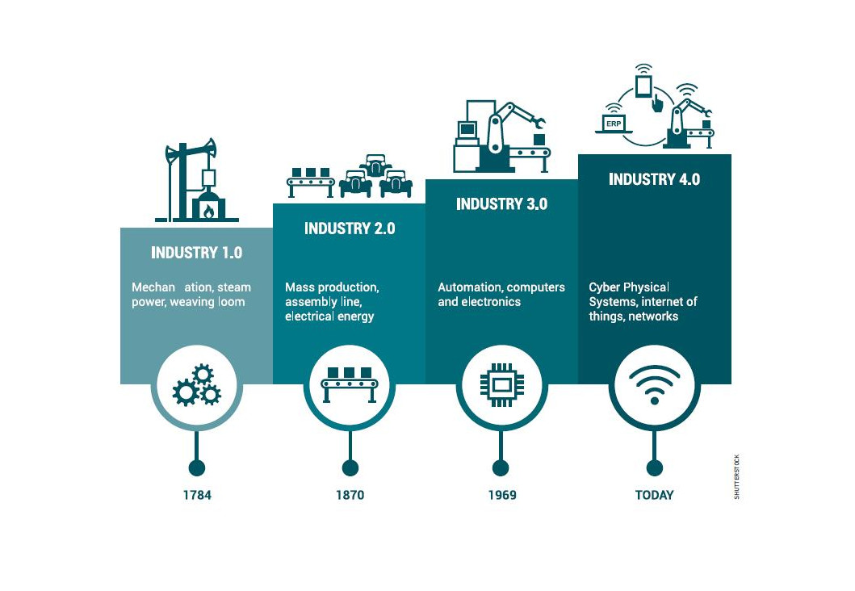
4th Industrial Revolution
5
The 4th Industrial Revolution (4BE / 4IR) has already begun. The countries that seek their evolution, as societies, participate in it by all means and in every way. Students, professors, universities, institutes, companies, institutions and politicians actively participate and contribute with their (corresponding) role to it.
The main technological dimensions, related to the 4th Industrial Revolution, are: Information Technology, Artificial Intelligence, Photonics, Nanotechnology, Biotechnology and Robotics.

Slide 6
4th Industrial Revolution
6
Looking ahead with a vision and with the aim of European countries active participation in the global educational process, it is advisable for the students of the modern European school to be informed and to deal, in essence, with nanotechnology, which is one of the most important dimensions of the 4th industrial revolution.

Slide 7
Nano size ..how small is it?
7
https://kapwi.ng/c/lgPpEadq

Slide 8
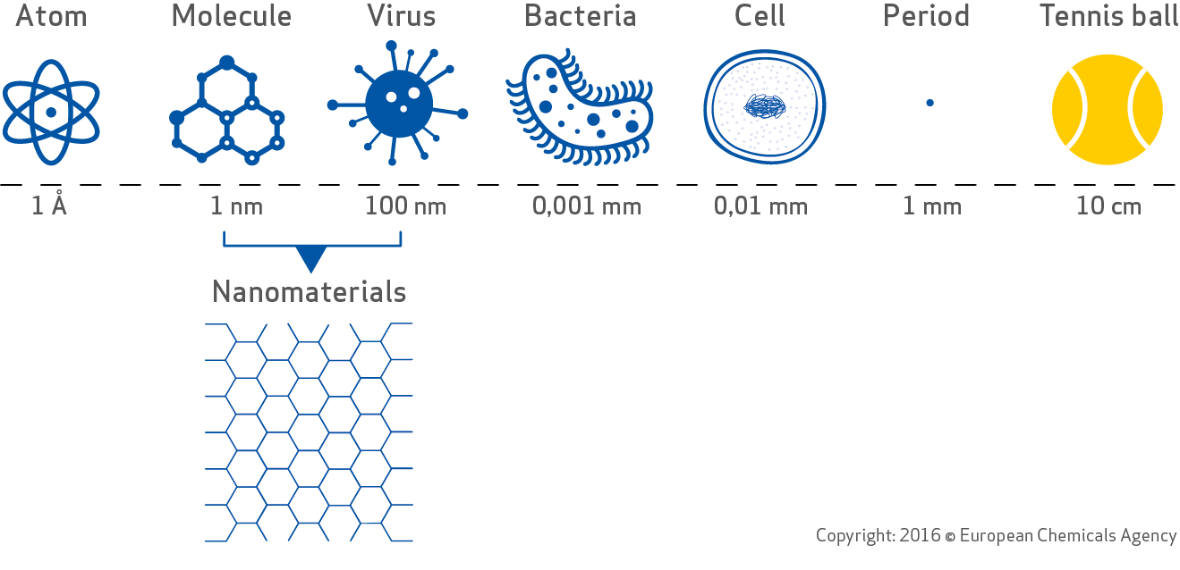
8
atom molecule virus bacterium cell 1 mm tennis ball
Nanomaterials
1– 100 nm

Slide 9
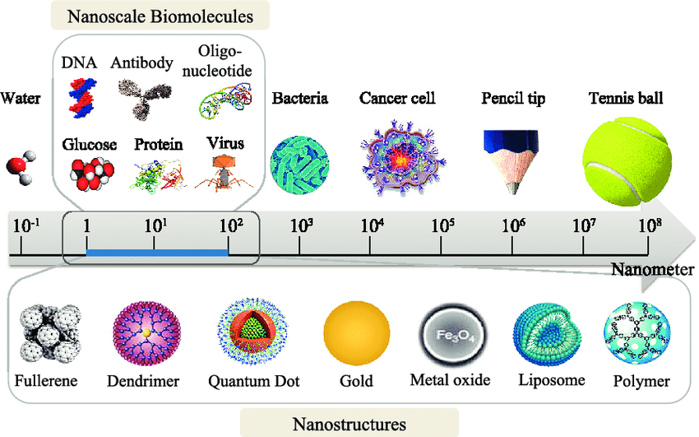
9
For example:
The DNA molecule is a material of the nanoscale (1-2 nanometers in diameter), as are subcellular supermolecular complexes, such as ribosomes (20 nanometers). The same goes for viruses (30-100 nanometers) and prions (4-10 nanometers).
The bacteria (germs) belong to the microclimate, as the dimensions of the microbes range from 200 and 300 nanometers (mycoplasmas) to 2-500 micrometers (E.coli = 2 micrometers and the giant bacterium Thiomargarita = 500-600 micrometers).

Slide 10
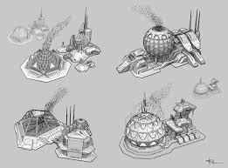
10
“I want to build a billion tiny factories, where one will be a model for the other, which will be put together at the same time. The principles of Physics, based on my estimations, do not contradict the possibility of handling material objects, person-to-person. This concept is not an attempt to violate the laws of nature. It is something that can happen and the reason why this has not yet happened in practice is that we are too big for that.‘’
Richard Feynman, excerpt from his lecture series
on Nanotechnology, in 1959,
entitled''Τhere's Plenty of Room at the Bottom''
https://transhumanistgr.wixsite.com/society/blog/η-μοριακή-νανοτεχνολογία-και-το-μοριακό-μέλλον-της-aνθρωπότητας

Slide 11
Nanotechnology
11
Nanotechnology is the study and technological creation of very small objects (located in the order of magnitude of nanometers / nm), which are applied in many fields, such as biochemistry, materials science, pharmacology, medicine and elsewhere.
The main activities of nanotechnology include the design and manufacture of nanomaterials at the level of the molecule and/or of the atom, as the case may be, as well as the various applications of these materials in industry and everyday life.

Slide 12
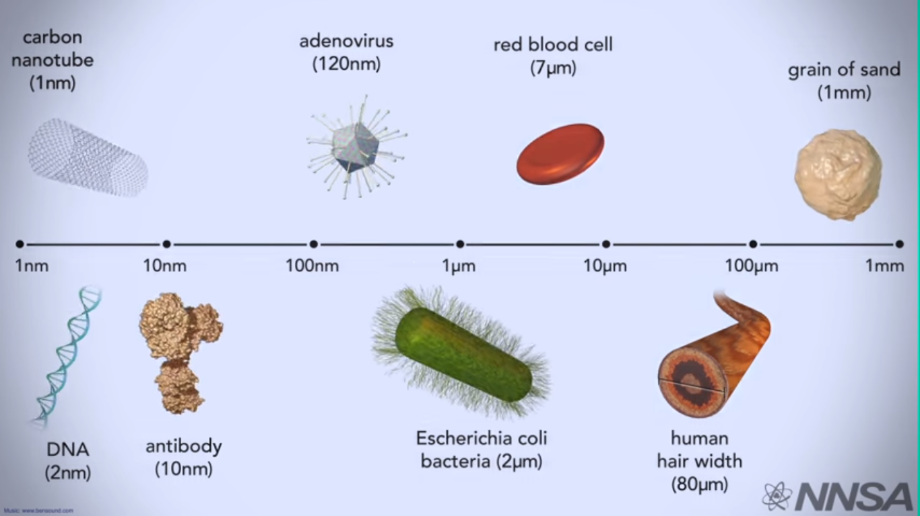
12
Let's look at the nanoscale
https://www.youtube.com/watch?v=sqv5ESP20tw

Slide 13
13

Slide 14
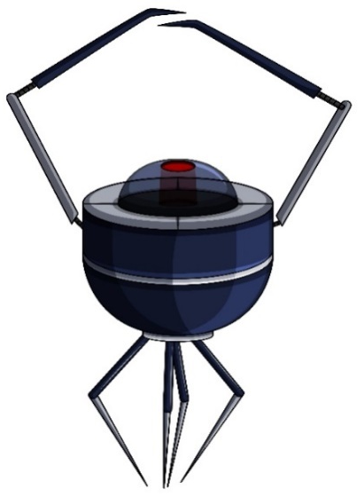
Nano - Materials
14
1. What is nanotechnology?
https://www.youtube.com/watch?v=dQhhcgn8YZo
2. How nanotechnology can change your life?
https://www.youtube.com/watch?v=IGjCOJqINPA

Slide 15
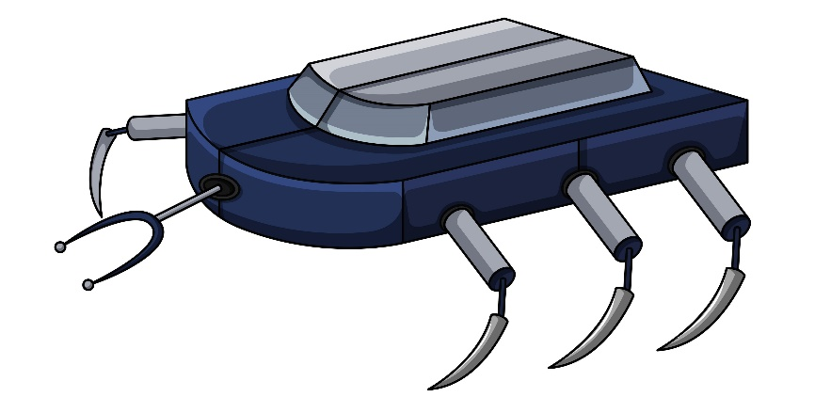
Nanomaterials
15
Nanomaterials Database

Slide 16
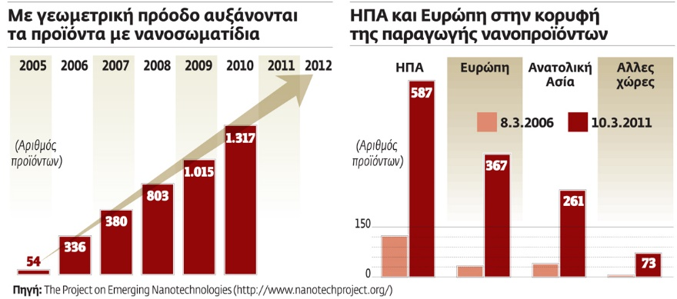
16
Nanoparticle products are growing exponentially
USA and Europe on top of nanoparticle products
USA
EUROPE
EASTERN
ASIA
OTHER
COUNTRIES
Number of products
Number of products
Source:

Slide 17
17
Carbon nanotubes
The applications of carbon nanotubes are numerous.
Imagine a carbon pipe as a graphene mesh (carbon atoms), which wraps and creates a cylindrical surface.
https://nucleus2012.wordpress.com/2015/05/22/οι-τρομακτικές-δυνατότητες-της-νανοτ/

Slide 18
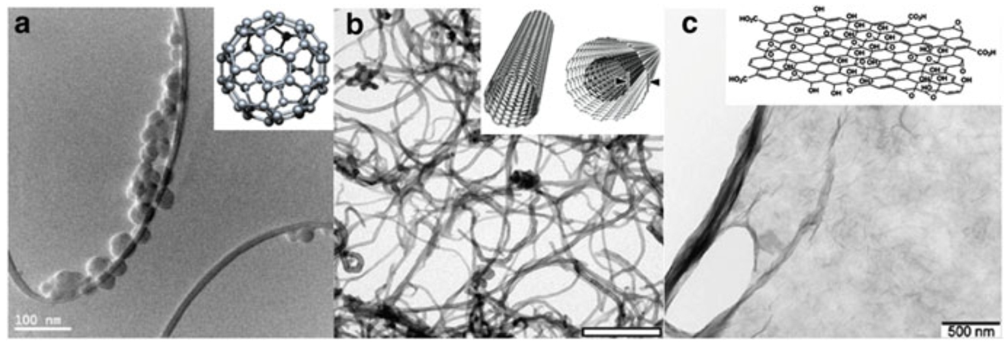
18
Fullerenia
Pictures from...
a) fullerenes C-60
b) multi-structured carbon nanotubes
c) single layer of graphene oxide
Alves et al 2019:6

Slide 19
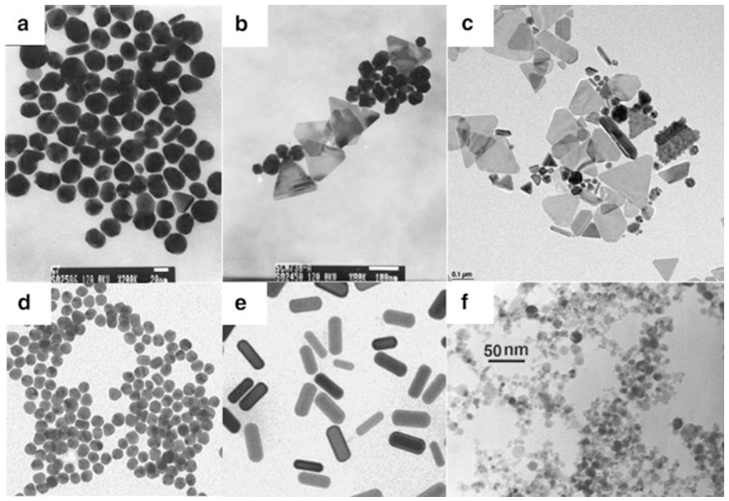
19
Pictures from...
a) spherical silver nanoparticles (Ag)
b) Ag nanoparticles (various shapes)
c) triangular and quadrilateral nano-mats Ag
d) global gold nanoparticles (Au)
e) gold nanorods (Au)
f) spherical nanoparticles TiO2
Alves et al 2019:13

Slide 20
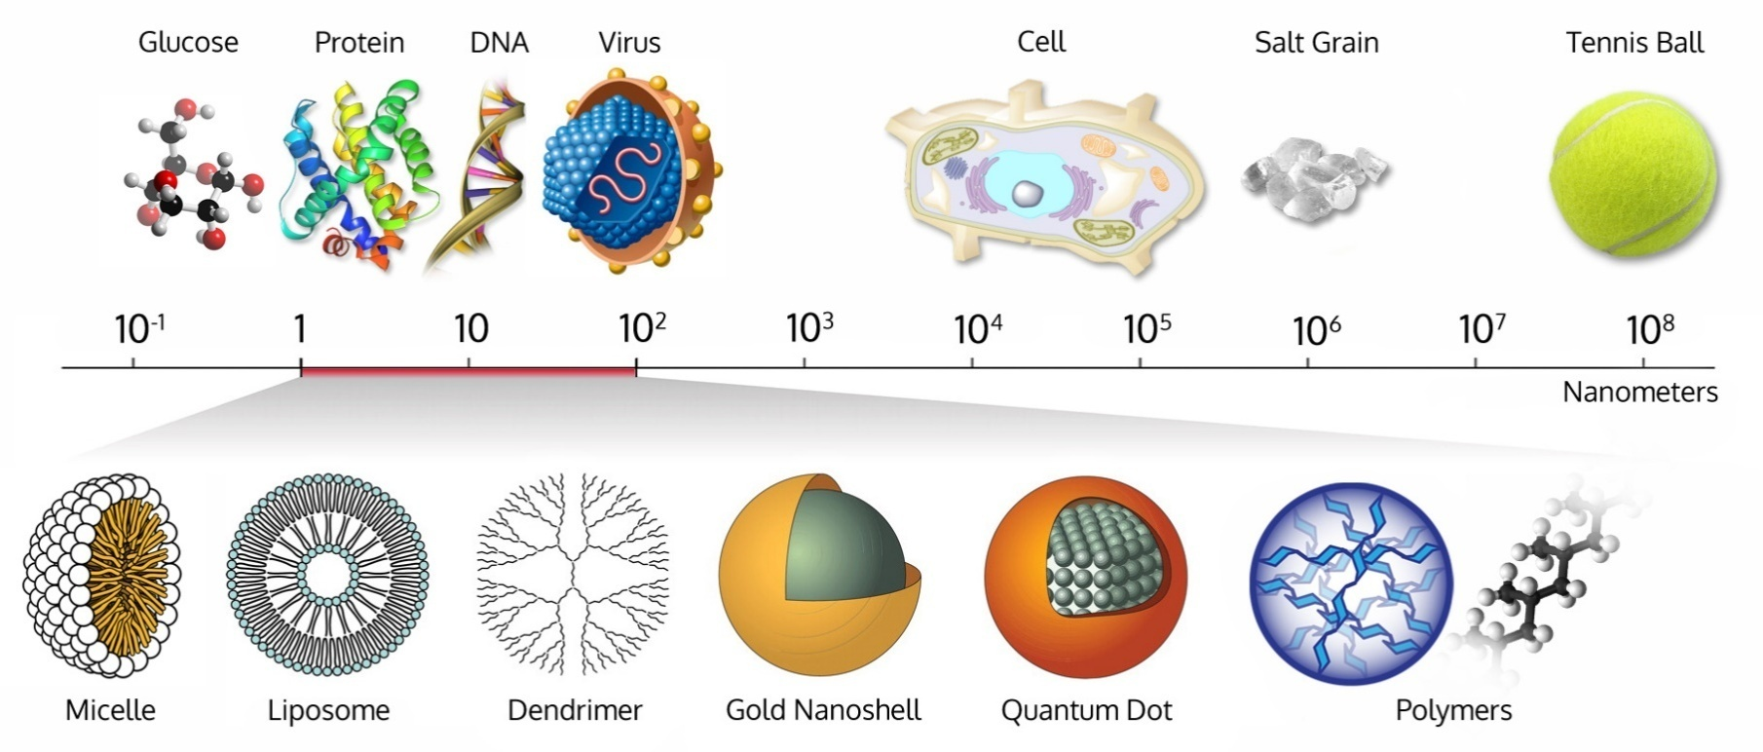
20
✓ Thanks to carbon nanotubes, it is possible to create lithium-ion batteries (the ingredients are simply ‘sprayed’ on a surface!)

Slide 21
21
Carbon nanotubes can be used to transport substances to specific cells in the body but also as sensors of substances inside our body. They can carry substances that will only kill cancer cells or speed up the process of repairing broken bones. They can also detect at an early stage e.g. proteins that indicate a serious illness, such as cancer.

Slide 22
22
✓Carbon nanotubes can help to protect the environment, as materials can be created that will absorb and trap oil spills. In addition, they can be used in so-called reverse osmosis membranes, creating relatively inexpensive and efficient water purifiers that provide a solution to the problem faced by many poor countries.

Slide 23
23
✓ In addition, it is possible to make materials with nickel nanoparticles, which can be "self-healing" if, for example, they are somehow cut. Also, the same particles can - due to changes in the structure of the material, when pressure is exerted on it (and then return it to its original state) - give the robots a feeling like touch!

Slide 24
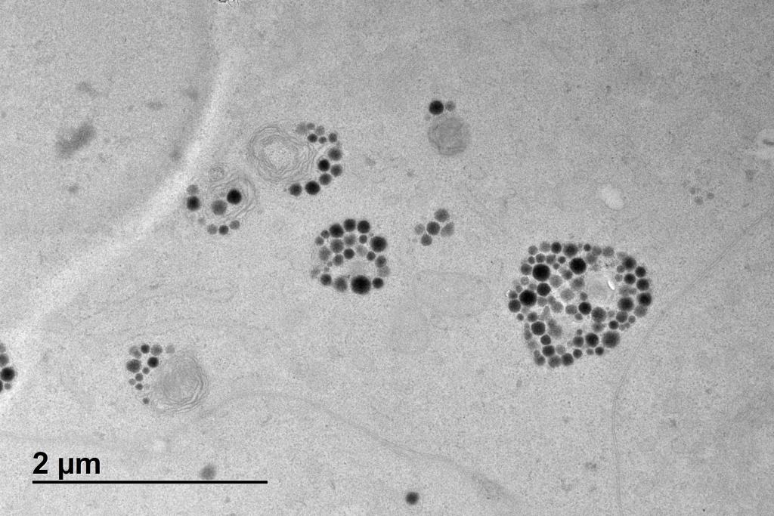
Medical Applications
24
The photo shows carbon nanoparticles (C) transported by glucose molecules and offering great potential for future use in the treatment and diagnosis of cancer.
©EC, 2019 , Kokalaria et al 2019

Slide 25
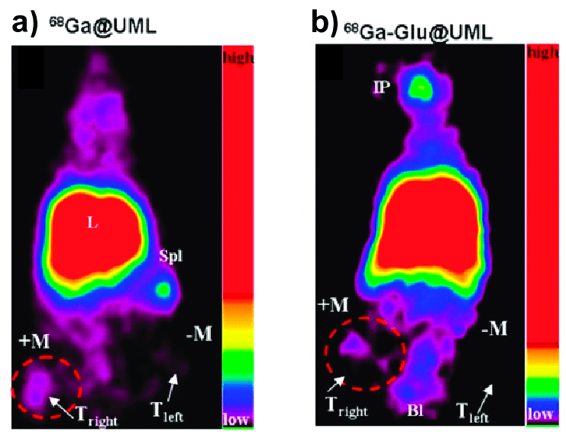
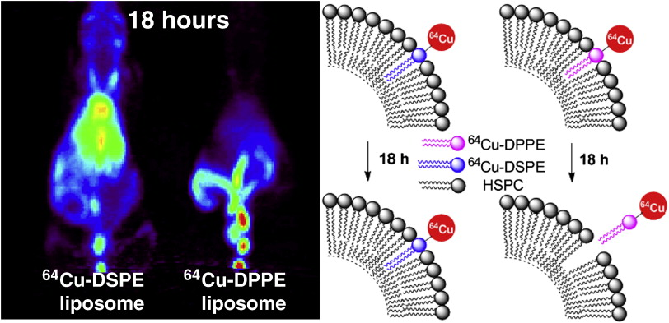
Medical Applications
25
Gallium nanoparticles(Ga)
Copper nanoparticles(Cu)

Slide 26
Medical Applications– PET scanning
26
Zirconium nanoparticles(Zi)

Slide 27
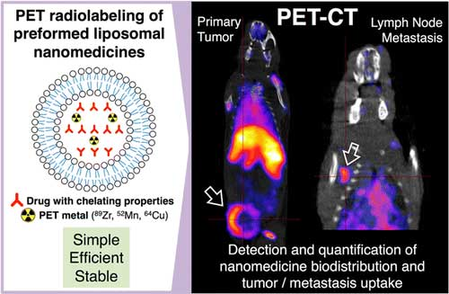
Medical Applications– PET scanning
27
Zirconium nanoparticles(Zi)

Slide 28
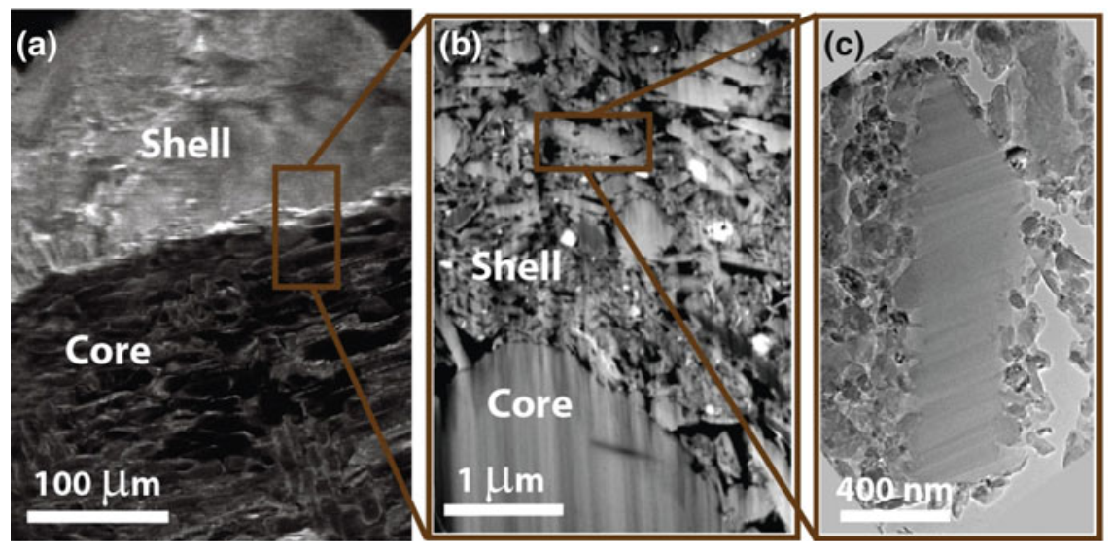
Medical Applications -
28
The photo shows the interface between the graphic core and the porous nano-surface.
Jorio 2016:89

Slide 29
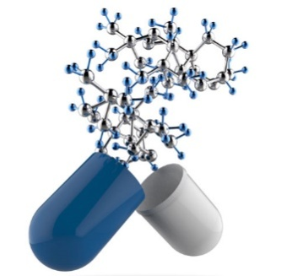
Biomedical Applications
29
Nanoparticles are used in the diagnosis of diseases, in the 'delivery' of drugs, in the gene therapy of cancer, in lung diseases and in the prevention of other infections.
(Singh 2017)

Slide 30
30
Food production
Nanomaterials, mainly metal-based and carbon-based nanomaterials, have been used for their absorption, displacement, and crop aggregation. The positive effects included increased vegetation rate, longer root and shoot length and more plant biomass in many crops - e.g. of corn, wheat, rye, soybeans, tomatoes.
(Singh 2017)

Slide 31
31
Safety
Nanotechnology increases the ability of tiny recording devices, which would be almost undetectable. Nanotechnology applications in gun design are a nightmarish scenario. For example, the "smart sphere", that is, an electronic sphere that could be controlled and targeted with great precision.
(Edwards @ chron.com)

Slide 32
32
Materials - Engineering
Nanotechnology has already 'offered' new ones - such as nanotubes and aerosols - which consist of very light but strong structures, with remarkable insulating properties. Also, robots with a length of only a few nanometers (nanorobots) help to build new materials and objects - corresponding dimensions.
(Edwards @ chron.com)

Slide 33
33
Energy
Nanotechnology is expected to make solar energy more economical, reducing the cost of manufacturing solar panels & related equipment as well as energy storage devices.
(Edwards @ chron.com)

Slide 34
34
Electronics and Computer Science
The electronics sector is expected to evolve due to nanotechnology applications. Quantum dots, for example, are tiny light-producing cells that can be used for lighting or for purposes such as display screens. Silicon chip can reach its limits - in the recording of integrated circuits - as nanotechnology will allow the construction of circuits with precision at the atomic level, it will be possible to expand these limits.
(Edwards @ chron.com)

Slide 35
35
Biofuels
Nanomaterials can increase the metabolism of microorganisms and improve the effectiveness of lipid extraction without harming microalgae.
Calcium oxide and magnesium oxide nano-particles were used as biocatalysts in biosynthetic oil distillation, with positive results.
(Singh 2017)

Slide 36
36
Textile industry
Nanotechnology finds application in textiles as nano-particles provide high durability, increased durability, comfort, lower production costs, etc. The use of nanotechnology allows fabrics to be made multifunctional with special functions (e.g. antibacterial protection (with silver nano-particles), protection from ultraviolet radiation.
(Singh 2017)

Slide 37
37
Cosmetology - Cosmetics
Numerous cosmetic products (from companies such as Lancome, Kara Vita, Nano-Infinity Nanotech, L'Oreal) based on nanomaterials are already on the market.
Many products (such as moisturizers, cleansers, anti-wrinkle creams, sunscreens) based on nano-materials are already on the market. Lipo-somes are used in the production of cosmetics as they are biocompatible, biodegradable, non-toxic, flexible and can easily and effectively 'trap' the active ingredients.
One of the main components of lipo-somes is phosphatidylcholine used in skin care products (moisturizer, lotion, creams, etc.), in hair care products (shampoo, conditioner).
Source: Singh, N. A. (2017). Nanotechnology innovations, industrial applications and patents. Environmental Chemistry Letters, 15(2), 185–191. doi:10.1007/s10311-017-0612-8.
(Singh 2017)

Slide 38
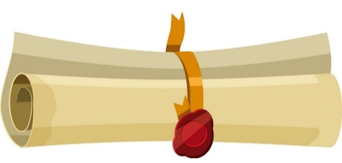
38
Economic Dimension
Nanotechnology, due to the special characteristics of nanomaterials, is widely used in many fields, such as medicine, agriculture, industry, etc. Despite its global applications, the nanotechnology sector is facing significant problems related to the issuance of patents.
The United States ranks first among the top twenty countries for submitting patents and publications on nanotechnology, while India ranks nineteenth for submitting patents and eighth for scientific publications.
(Singh 2017)

Slide 39
Patents
39
https://www.gapminder.org/tools/#$chart-type=bubbles

Slide 40
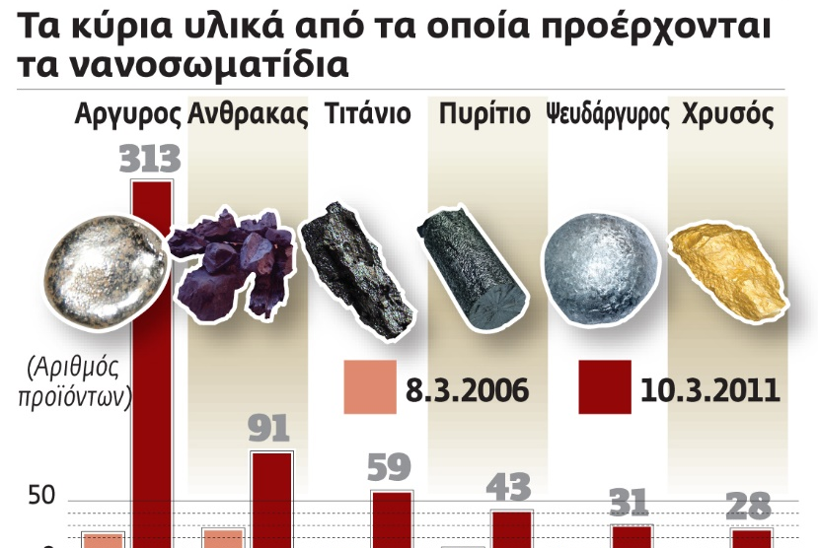
40
Τhe main materials from which the nanoparticles are derived
Silver Carbon Titanium Silicon Zinc Gold
Number
of
products
0

Slide 41
Nanites….
41
The nanites are evolving-Star TrekTNG
https://www.youtube.com/watch?v=P-3MFjkyRtk

Slide 42
Environment
42
Leaving out some Science Fiction scenarios (for example, the so-called "gray goo" scenario, where self-copying nano-bots consume everything around them to make copies), is likely to have a negative impact on the environment, as possible new nano-toxins and nano-particles (with unknown consequences) will be found in water, carbon and food circles.

Slide 43
43
"When artificially made nano-particles are released into the atmosphere, they can undergo different physicochemical changes, which lead to changes in their properties and their impact on the environment. There is a growing concern that human exposure to certain types of such particles can have a significant impact on health. We need to treat nano-toxicity as a new class of toxicity that is little known, giving special weight to sensitive populations, such as children, whose bodies are more vulnerable than adults. "
https://www.tovima.gr/2012/04/22/science/poso-apeilei-tin-ygeia-mas-i-diadosi-twn-nanoproiontwn/

Slide 44
44
Deformed chamomile flowers. The spectral lines show contamination of lead, gold, calcium, magnesium, potassium.
Gatti & Montanari 2015:254
(*Plant nanotoxicology – Dietz & Herth 2011)

Slide 45
45
nanoparticles
… from the environment ... to man
water
environment
atmosphere
food
chain
soil
underground water

Slide 46
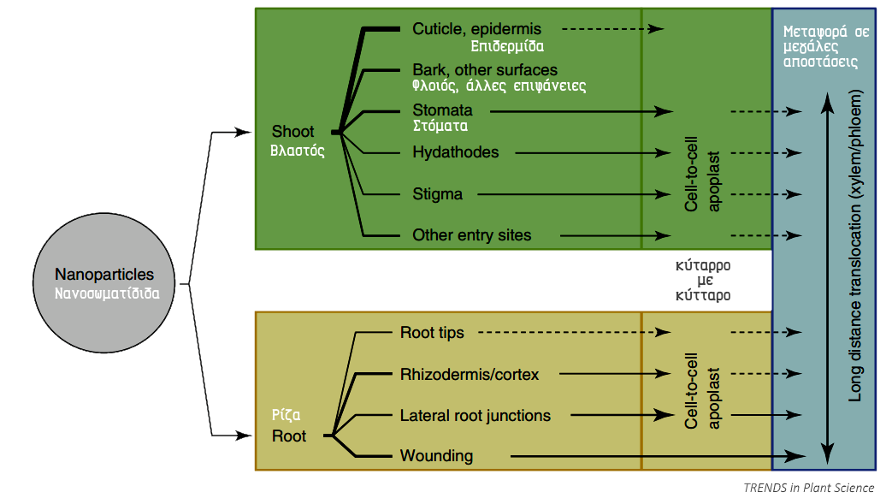
46
Nano-somal pathways, in plant uptake and displacement processes. The thickness of the lines indicates their considered importance in the phenomenon:
… thick lines equals to significant transport through these roads
... Intermittent lines equals to very low transport through these routes (Dietz & Herth, 2011)
The research on the use of nano-particles in plant development has already been used as a homeostasis process to obtain specific levels of ingredients that they need. Source: https://www.dovepress.com/nanotechnology-in-agri-food-production-an-overview-peer-reviewed-fulltext-article-NSA

Slide 47
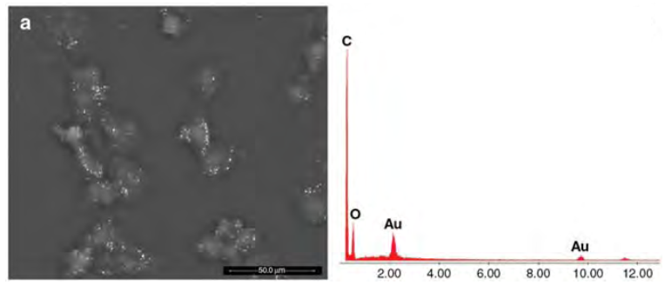
Nanotoxicity
47
Top photo: a 3T3 cell during mitosis in contact with hematite (Fe2O3)
Bottom photo: 3T3 cells after infection with gold nano-particles (white dots)
(Gatti & Montanari, 2015:19-25)

Slide 48
Nanotoxicity
48
Above photo: presence of a cluster of nanotubes - in larger
enlargement we see pollution from aluminum and iron
Bottom photo:
CeO₂ nanoparticles in 3T3 cells - nanoparticles meet the
extracellular space blocking normal cellular communication and movement.
(Gatti & Montanari, 2015:19-25)

Slide 49
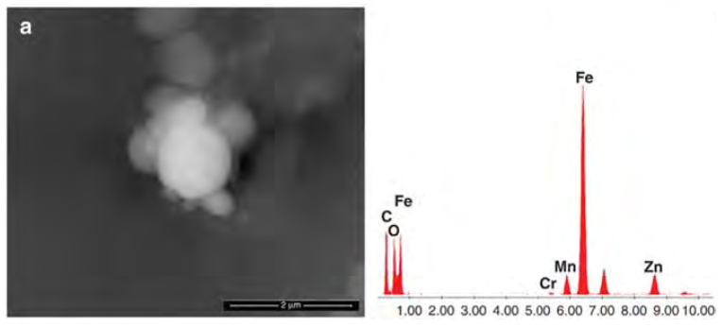
49
Top photo: Red blood cell with human blood red blood cell and an unusual biological aggregate containing zinc-calcium particle.
Bottom photo: Spherical fragments found in a kidney biopsy. The pellets contain iron, zinc, manganese and chromium.
(Gatti & Montanari, 2015:32,73)

Slide 50
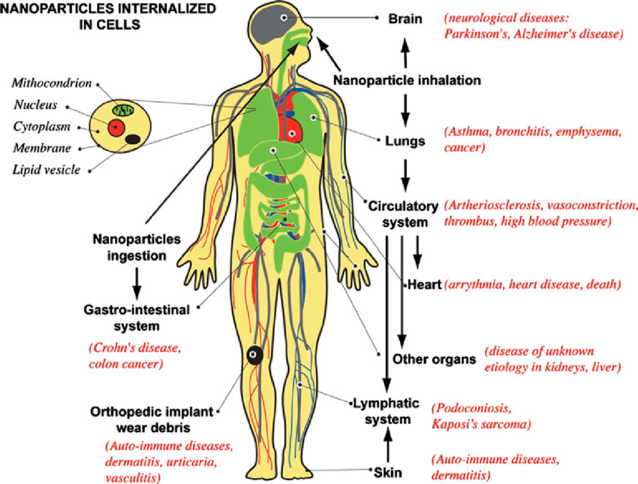
50
… from the environ-ment ...
to man…

Slide 51
Subject of Contradiction
51
The question then arises as to whether the use of nano-materials causes health problems and their use has adverse effects on the environment or whether the problems are limited and the technological applications are, indeed, beneficial to the environment and, consequently, to the human health.
Subject of Contradiction
The use of nano-materials causes serious health problems in humans

Slide 52
Health and Protection Issues
52
Silver nanoparticle risks and benefits: Seven things worth knowing
https://www.youtube.com/watch?v=Yz6LuH-11II

Slide 53
Health and Protection Issues
53
Manufactured Nanomaterials: Health, Safety and the Environment
https://www.youtube.com/watch?v=MkpcUpattE8
Safety of manufactured nanomaterials
http://www.oecd.org/env/ehs/nanosafety/
http://www.oecd.org/env/ehs/nanosafety/45910212.pdf (ΟΟΑΣΑ)

Slide 54
54
Thank you… Dimitrios I. Sotiropoulos

Slide 55
Notes on the teacher from now on…

Slide 56
Video of the Presentation
D1. https://www.youtube.com/watch?v=CjpXj2BqJBY
D.7. https://kapwi.ng/c/lgPpEadq
D.14. 1. https://www.youtube.com/watch?v=dQhhcgn8YZo
D.14 2. https://www.youtube.com/watch?v=IGjCOJqINPA
D.41. https://www.youtube.com/watch?v=P-3MFjkyRtk
D. 52. https://www.youtube.com/watch?v=Yz6LuH-11II
D.53. https://www.youtube.com/watch?v=MkpcUpattE8

Slide 57
Correlation of Nanotechnology and School Knowledge Objects
The issue of nanotechnology and the use of nano-materials are related to concepts, phenomena, relationships, and mechanisms contained in school unit sections (listed below).
Therefore, they fall within the cognitive objectives of the curriculum and the instructions, which are additionally sent to the schools each school year.

Slide 58
Related Courses
Biology: 2nd Gymnasium, 3rd Gymnasium, 2nd General Lyceum
Chemistry: 2nd Gymnasium, 3rd Gymnasium, 2nd General Lyceum

Slide 59
Related Courses per class
2nd Gymnasium
Βiology (1.2,4.1,4.2)
Chemistry (1.1, 1.2, 1.3, 2.1, 2.4, 3.4)
3rd Gymnasium
Βiology (1.2, 2.2, 2.4, 5.1, 5.2)
Βiology (4.2, 4.3, 4.6)

Slide 60
Related Courses per class
2nd General Lyceum
Biology (1.1,1.2, 2.2, 2.3)
Chemistry (1.1, 1.4, 2.8, 5.1, 5.2, 5.4)

Slide 61
For example 2nd General Lyceum
In Biology (Units 1.1 and 1.2 (Objectives within the book) students are expected to:
list the most important groups of organic macromolecules (proteins, nucleic acids, carbohydrates, lipids) and describe their structure. As a result, students are expected to associate macromolecules (proteins, nucleic acids, carbohydrates, lipids) with nano-materials and, knowing in the same section data on DNA and RNA, approach the capabilities of nanotechnology to act on this level.
In sections 2.2 and 2.3 of the same book, the cell is studied (the relevant objectives are listed in the corresponding file of the introductory training) and students are expected to relate the particular characteristics of the cell to the nano-scale and the possible interactions for the various parts of the cell at the nano-scale level. The sections 1.1., 1.2. of the book of the 3rd Lyceum can be used for the lesson of the 2nd Lyceum (instructions), where the homeostasis (the relevant objectives have been mentioned above) as well as the microorganisms / microbes are studied, while it is expected to be related, and due to scale, to the possible applications of nanotechnology.

Slide 62
For example 2nd General Lyceum
In the subject of Chemistry (Unit 1.1, APS: p. 2678) the students perform:
link carbon compounds to their applications in chemical technology, biochemistry and everyday life (for example, drugs, biopolymers, dyes, textile fibers, cosmetics),
interpret the number of carbon compounds based on the structure of the atom C. In general, there is an important reference to carbon, which is a key component of a class of nano-materials and students are expected to assess the value of the element for the development of new materials.
Section 1.4 discusses isomerism and different properties due to layout (APS, p. 2679) and students are expected to:
to state what is called isomerism and to distinguish its species.
This goal is related to the different properties of nano-materials over the rest and it is expected that students will make such a semantic connection.

Slide 63
For example 2nd General Lyceum
In the subject of Chemistry
Section 2.8 discusses the derivatives of hydrocarbon combustion, air pollution, and the effects of industrial emissions (APS, p. 2684). We expect students to take this into account when formulating their arguments and this dimension. Chapter 5 (introduction, sections 5.2 and 5.4) describes substances that are large molecules and are widely used. We expect students to make the necessary connections between polymers (and silicones), which are natural (already existing) or artificial (new) materials and nano-materials.
In addition, the following objectives are explicitly stated in the APS (p. 2682) which the students seek to:
- explain that nano-materials are cutting-edge materials with applications in science and technology and
- to report applications of nano-materials in everyday life.
Elements that students will approach using the supervisory material and the help of the teacher (no relevant material is included in the official textbook).

Slide 64
At the same time, however, with the help of educational material…
which will be available to teachers and students, will give the opportunity to expand the cognitive field of students in relation to the existing objectives of the curriculum, with the addition of new, related to the individual subjects, which are included on the issue of the use of nanomaterials and nanotechnology applications in general.

Slide 65
The educational guide…
Incorporated into formal education, it proposes an interdisciplinary approach to the subject matter of nanotechnology and its materials.
Through the interdisciplinary activities proposed and the educational material that will be given, the students will get to know the dimensions of the issue, the benefits from the use of nano-materials as well as the possible effects on the natural environment and human health from the use of nano-materials.

Slide 66
Additional notes
It is important to make it clear that: the proposed sections contain concepts, phenomena and relationships or mechanisms that, potentially, can be related to the present educational material. The correlation will be made with the help of the teachers and in this way - although indirectly - the necessary connection with the existing objectives of the Curriculum for the respective courses will be made. In some (extremely few) cases, the proposed sections are outside the proposed (this year's) material. However, the proposed objectives can be excellent material for the needs of this particular educational guide. Also, concepts and phenomena that exist in the material of previous classes, are considered known and can be mentioned, briefly, based on the reports above.
For high school students, the educational guide could be applied in the context of school activities, innovative creative research projects (projects), groups but also in any case enrichment and expansion of the teaching of courses referred.
Such creative work is listed below:
•http://www.iep.edu.gr/images/IEP/EPISTIMONIKI_YPIRESIA/Epist_Monades/B_Kyklos/Genika/2017-10-
•31_Xhmeia_BLykeioy_nanoylika_ypodeigma1.pdf
•http://www.iep.edu.gr/images/IEP/EPISTIMONIKI_YPIRESIA/Epist_Monades/B_Kyklos/Genika/2017-10-31_Xhmeia_BLykeioy_nanoylika_ypodeigma2.pdf

Slide 67
Terminology Related to Nanotechnology and Nano-materials

Slide 68
Terminology _1
Nanomaterials: Engineered nano-materials (ENMs) are chemicals or materials whose size ranges between 1 and 100 nm (nanometers, 10-9 meters - various classifications: zero dimension (0D) <100nm, such as nano-particles and quantum dots, one-dimensional (1D) <100nm, such as nano-tubes, fibers and nano-wires, two-dimensional (2D) <100 nm minutes and ultra-thin films, coatings, multilayer structures, etc.). Nano-materials have specialized physicochemical properties and quantum properties compared to larger particle materials. The need for new, advanced materials and systems with new properties and behaviors, led to the creation of nano-materials. Procedures for the production of nano-materials include a) a mechanism for depositing atoms or molecules from the gas phase on the surface of a solid material (bottom-up approach) or b) the creation of a specific structure through e.g. ion bombardment, lithography (top down approach) (Vlachogianni et al. 2014, Nano-materials Engineering and Nanotechnology Applications, http://bit.ly/2LyAr9H; Haritidis & Kordatos from the website of the course Nano-materials and Nanotechnology)

Slide 69
Terminology _2
Nanotechnology: is the study and technological application of extremely small objects, which are applied in all other fields of science, such as chemistry, biology, physics, materials science and engineering, pharmacology, etc. Nanotechnology is defined as the field of engineering applications that use molecule-sized structures. The scale for measuring these structures is the nano-scale which gives their sizes in nanometers (nm), that is, in multiples of one billion meters. For the most part, in the field of nanotechnology, interest structures are usually less than 300nm in size. By comparison, the cross section of a human hair is about 60,000nm, a DNA molecule 2 to 2.5 nm, and a water molecule almost 0.3nm. The activities of nanotechnology include the design and construction of materials at the level of the molecule and the individual, as well as the various applications of these materials. Matter, at the levels considered by nanotechnology, exhibits quantum properties, completely different from the properties of macroscopic quantities that surround man in his daily life. Therefore, nanotechnology has an interdisciplinary character, as it combines perfectly with the other sciences whose structures are measured on the same scale (nanoscale), such as quantum physics, chemistry, biology, computer science and microelectronics, etc. http://bit.ly/2JLy8xV
Fullerenia: Each molecule is in the form of a regular twentieth century, consists of 60 C atoms and resembles a soccer ball. See the figure next to and http://bit.ly/2IUA7OA.

Slide 70
Terminology _3
Carbon nanotubes: are concentric graphite (graphene) cylinders, closed at each end with five-membered rings. They were discovered in 1991 by Sumio Iijima. Nano-tubes can be multi-floating with a central tube surrounded by one or more layers of graphite or monofilament, where there is only one tube and no extra layers of graphite. When nano-tubes are grouped, we have the so-called nano-tube arrays (Wikipedia). See here: http://bit.ly/2XVMtMJ,
Nano-toxicity: When artificially made nano-particles are released into the atmosphere, they can undergo different physicochemical changes, which lead to changes in their properties and their impact on the environment. There is growing concern that human exposure to certain types of such particles can have a significant impact on health.
Bioavailability: Bioavailability refers to new drugs and bioavailability in essentially similar drugs, those whose patent protection has expired and are manufactured by any pharmaceutical company. The definition of bioavailability as determined by the Academy of Pharmaceutical Sciences is 1.2: "The measurement of the relative amount of a given drug that reaches the general blood circulation in relation to the rate at which it occurs."

Slide 71
Terminology _4
Oxidative stress: Oxidative stress in a cell or organism is called the pathological condition, which results from the imbalance between the levels of anti-oxidant mechanisms and oxidizing agents (active forms of oxygen, nitrogen and free radicals) (Ntounoussi, 2009).
Simulation: With this self-adjusting mechanism, the programmed temperature is kept constant, for example in a device such as an ironing iron, regardless of the temperature of the external environment. Similar mechanisms of self-regulation are found in living organisms. In order to function properly, they must be able to maintain their internal environment (composition and amount of liquids, temperature, pH, etc.) relatively stable, regardless of the conditions of the external environment in which they live. This ability is called homeostasis and, in order to achieve it, energy is required. (School C Biology Guide, Chapter 4).

Slide 72
Nano-toxicity
Laboratory studies have shown that carbon nano-tubes are cyto-toxic and cause granulomas in animal lungs. Other nano-particles, which contain metals and metal oxides (such as copper (Cu), cobalt (Co), titanium dioxide (TiO2) and pyrite dioxide (Si02), have also been shown to have inflammatory and toxic effects on cells. TiO2 nano-particles have been shown to cause DNA damage as well as chromosomal abnormalities. Hydro-xyapatite nano-particles, a substance closely related to the mineral component of bones and teeth, have been found in studies to cause cellulite.
Source: Dunphy Guzmán, K. A., Taylor, M. R., & Banfield, J. F. (2006). Environmental Risks of Nanotechnology: National Nanotechnology Initiative Funding, 2000−2004. Environmental Science & Technology, 40(5), 1401–1407. doi:10.1021/es0515708

Slide 73
Additional Videos
1 http://bit.ly/2GnNyp8 (TEDx «The next step in nanotechnology»)
2 https://youtu.be/VDYD5U5UtR4 (TEDx «Redefining nanotechnology»)
3 https://youtu.be/KXwW6F181i0 (TEDx «How Nanotechnology Will Change Our World»)
4 https://youtu.be/ZpSZdQUIlpg (TEDx «Nanotechnology: The Spies Inside Living Things»)
5 https://youtu.be/UttB1VHXzug (TEDx «The possibilities of nanotechnology»)
6. https://www.youtube.com/watch?v=IU4A4h1ACJs (Nanotechnology in Cancer Research | Jessica Winter)
Designed by ibrandify / Freepik

Slide 74
Additional Material
https://ec.europa.eu/research/industrial_technologies/pdf/nano-brochure/nano_brochure_el.pdf

