Slide 1
Debate
The future of humanity depends on the conservation of honeybees
Topic: Ecology / Food production

Slide 2
Basic terms
Bees - Nowadays, it is estimated the existence of approximately 20,000 species of bees. These insects exhibit several life habits, from solitary to highly social bees, which implies in a broad spectrum of habitats, because it involves different feeding and mating habits, besides varied nesting sites. Regarding the use of food resources and nesting sites, groups of bees can be categorized into generalists or specialists. The specialist group, with specialist habits, often requires morphological and behavioral specialized adaptations.
Honeybees - The European honey bee, Apis mellifera L., is the most commonly managed bee in the world. A highly adaptable species, it has a native range that stretched from the southern parts of Scandinavia to Central Asia and throughout Africa. Since the 1600s, however, A. mellifera’s range has expanded to nearly all habitable corners of the globe. Most of the European honey bee’s range expansion has been the result of deliberate human transport. ‘‘Like the dog, the honeybee (sic) had accompanied man on most of his major migrations, and some of the early settlers in each part of the New World took hives of bees with them”. Unlike dogs however, honey bees were imported by settlers for their ability to make honey and bees wax. Honey was the only sweetener available to early African, Middle Eastern and European civilizations, and demand for the product no doubt lead to the domestication of bees by the Ancient Egyptians sometime before 2600 BCE. The practice of keeping bees was passed to the ancient Greeks by 650 BCE, who in turn passed the art to the Romans (by 150 BCE) who spread the art throughout what would become medieval Europe. It was the descendants of medieval European beekeepers who eventually spread both the practice of beekeeping and the bees themselves around the world (Ransome, 1937).
Pollen - the small spore, plays an important role in the sexual reproduction of angiosperms as does the sperm in the animals. However, the pollen grains are nonmotile requiring some foreign agent for their carry over to the female counter part. Wind, water and gravity are some of the abiotic agents, but through them the pollen carryover is undirected and very large number of pollen has to be produced to ensure successful pollination. Still the effectivity of pollination by these agents is low. On the other hand in a large number of plant species, pollination is effected by the bioagents. This is especially true in plants exhibiting self-incompatibility, protandry or protogyny. Pollination by bees is of special importance. Efficiency of pollination by bioagents is the direct measure of mutualism specialization which is reflected in terms of success of reproduction as evidenced by quality and quantity of produced seeds/fruits.

Slide 3
Pollination - the transfer of pollen grains to the stigma of the plant gynoecium is a crucial step in the sexual reproduction of flowering plants. The majority of flowering plants rely on animals for the transfer of pollen (Nabhan and Buchmann 1997; Renner 1988). Because flower visitors gain no direct benefit by pollinating flowers, rewards must lure them. The most common way plants attract animals to visit their flowers is by providing food such as nectar, pollen or oils. While searching for these rewards in the flower, pollen from the flower’s anthers may stick to the body of the animal. When the animal visits subsequent flowers in search of more rewards, pollen from its body may adhere to the stigma of these flowers and again, new pollen may stick to the body of the animal.
Importance of pollination (History) - in agriculture has been recognised for millennia (Kevan and Phillips 2001). Ancient Assyrian temple carvings depict winged deities pollinating female date palms with male flowers to ensure that dates would form on their trees (Buchmann and Nabhan 1996). Old Mayan screen fold books (the Madrid Codex, now housed in a Madrid museum) indicate that the ancient Maya of Mesoamerica kept stingless bees (Melipona beecheii), indicating that they knew how to manage and propagate captive colonies in log hives. Pollination was discovered by Koelreuter (1733–1806) and Sprengel (1750–1815) who are regarded as father of pollination ecology. Much of this ancient knowledge was lost until essentially modern times, with the rediscovery of sexuality in tulips by Arthur Dobbs in 1750 and other early floral biologists. The irony, however, is that although the importance, and fragility, of pollination for agriculture and Nature conservation has been known for a long time, there appears to have also been a popular belief that flowering plants always somehow seem to get pollinated and bear fruits and seeds and carry on into the next generation. Thus the science of pollination ecology has not advanced adequately, and this makes ample room for new and established researchers to contribute to knowledge about pollinators and the plants they pollinate, whether in natural or agroecosystems.
Animal pollination - is necessary in the life cycle of many plant species. An estimated 87.5% of the world’s flowering plant species are animal pollinated, with 75% of the world’s major crop species benefitting to some degree from animal pollination. Animal-pollinated plants are also used for medicines, forage, and construction materials, and play a crucial role in the long-term maintenance of biodiversity and natural ecosystems.

Slide 4
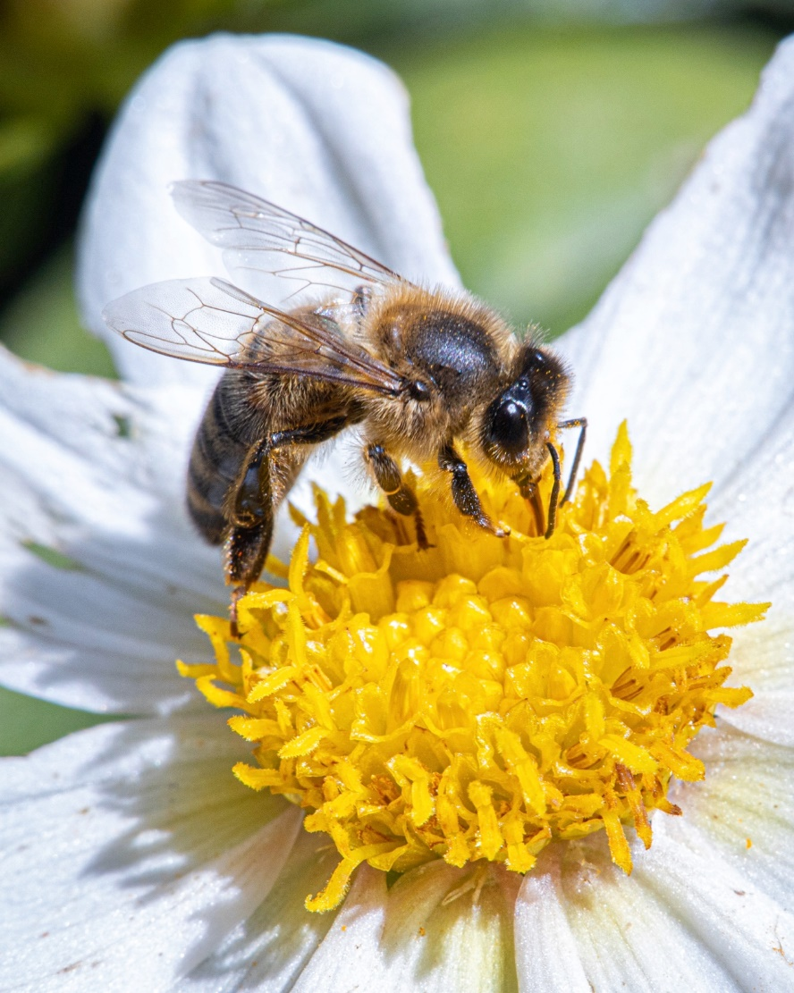
Introductory questions
Why are bees important?
What bees do for us?
Would we starve without bees?
How much does agriculture depend on pollinators?
What other pollinators are there?
Source: Sebastien Rosset / Unsplash

Slide 5
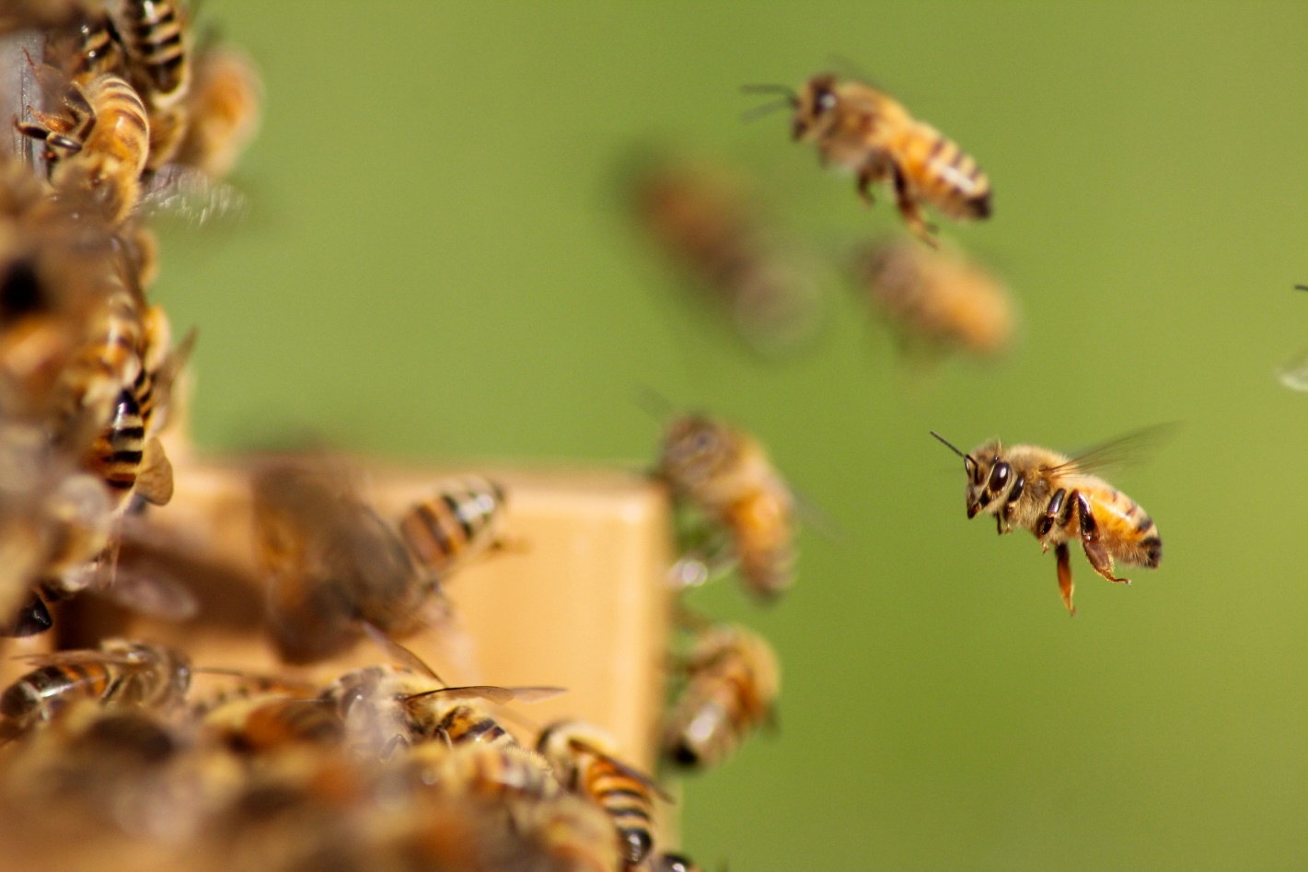
RESOLUTION: The future of humanity depends on the conservation of honeybees
Source:
Damien Tupinier / Unsplash

Slide 6
PRO
CON
We cannot imagine the world without bees.
Bees are the most precious pollinators of plants.
Bees are threatened by extinction and should be preserved.
Bees need to be preserved because they pollinate crops key for our diet.
1. We don't have to imagine a world without bees because it actually exists.
2. Bees are far from being the only valuable pollinators.
3. It is not necessary to invest additional efforts in the preservation of bees since they are not endangered.
4. In no way do bees contribute to the increase in yields of plants which are most used in human diet.

Slide 7
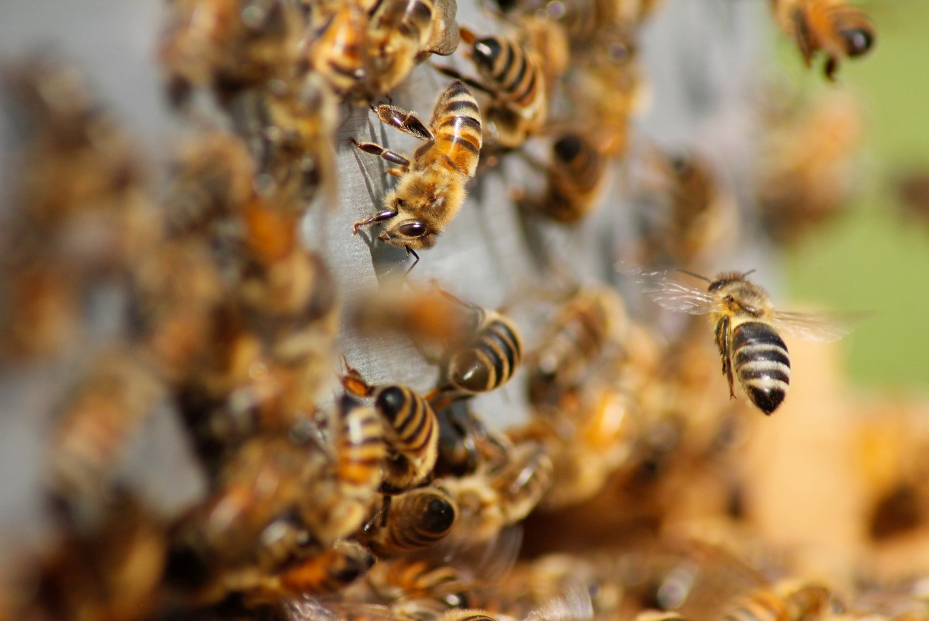
1. We cannot imagine the world without bees. (PRO)
Source:
Damien Tupinier / Unsplash

Slide 8
The partnership between flowering plants and pollinating insects, especially bees, is one of the most widespread and significant symbiotic interactions on Earth.
Now the need to feed our burgeoning population, coupled with the agricultural means to that end – a plethora of pesticides, the unabated loss of natural habitat and the translocation of alien species and diseases - are driving wild and managed bee populations into a very steep decline.
Seventy percent of the crop species eaten by humans depend wholly or partly on pollination and recent estimates put the economic value of insect pollination at over £121 billion - representing at least 10% of the value of the world's agricultural production.
The value of bees in pollination is undisputed and well documented.
During the last century the publication of research papers in this area has grown exponentially, and in just the last five years, some 23,000 items have appeared

Slide 9
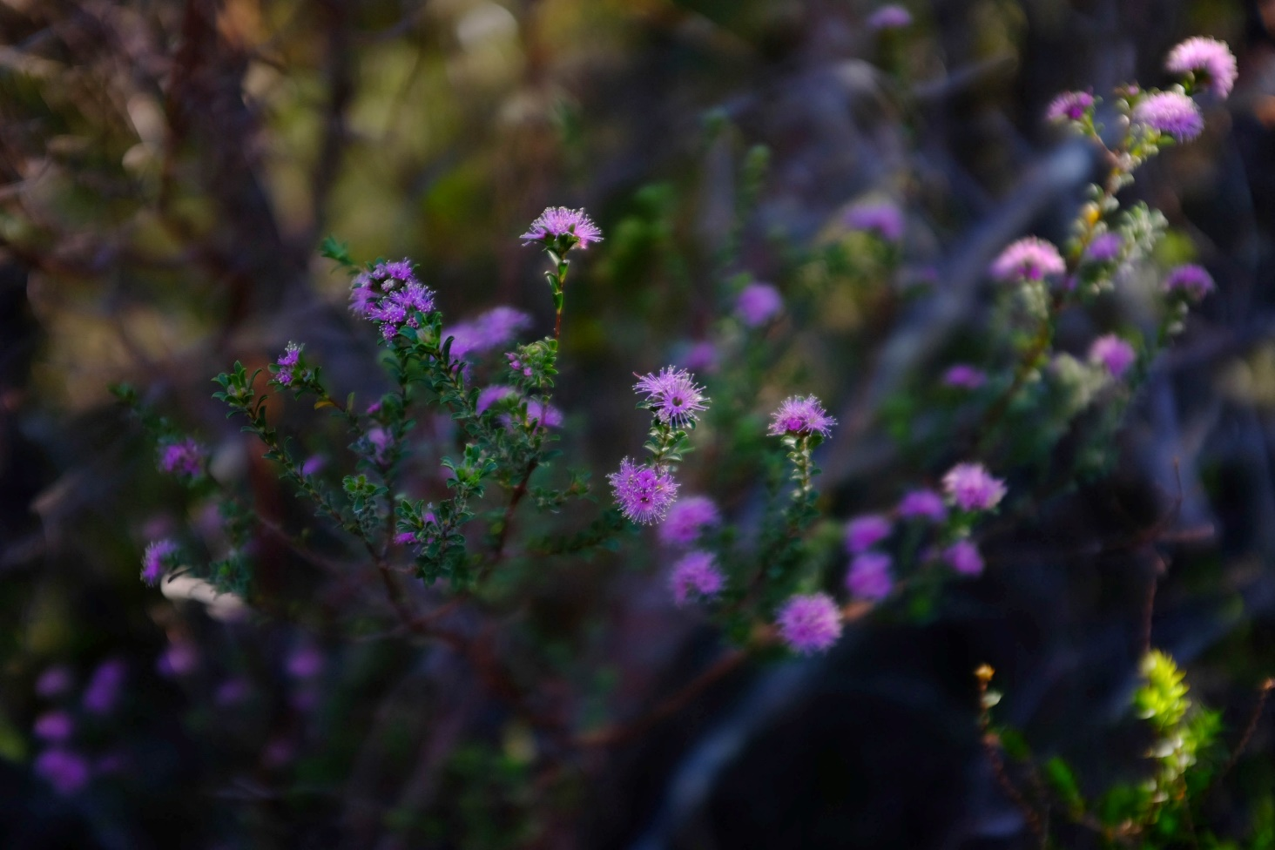
1. We don't have to imagine a world without bees because it actually exists. (CON)
Извор:
Ranah Malberg / Unsplash

Slide 10
Instead of lamenting on the extinction of bees, we should devote time to studying ecosystems which exist without bees
Remote Macquarie Island, halfway between New Zealand and Antarctica, has provided scientists with the first glimpse of a world without bees.
A contrast to the colorful flowers most of us are used to, Macquarie Island's flowers come in one color: green, and not by accident. On the island, flies are the dominant pollinator.
Flies have very different color vision system and preferences to birds and bees, the flora on the sub-Antarctic island hosts flowers with a distinctive green appearance, unlike any other in the world.

Slide 11
Vision scientist at RMIT University, Adrian Dyer, said the power of the pollinator had influenced the color of the flowering plants' blooms.
The researchers spent almost twenty years looking for an environment without bees, adding that it was always going to be a remote corner of the globe because where humans go, generally bees are introduced as well.
"If we don't have birds and bees and we have to rely on flies as pollinators then we may have to think about genetically engineering completely different-looking flowers."
Macquarie Island is an extreme case which confirms that ecosystems can survive without bees.

Slide 12
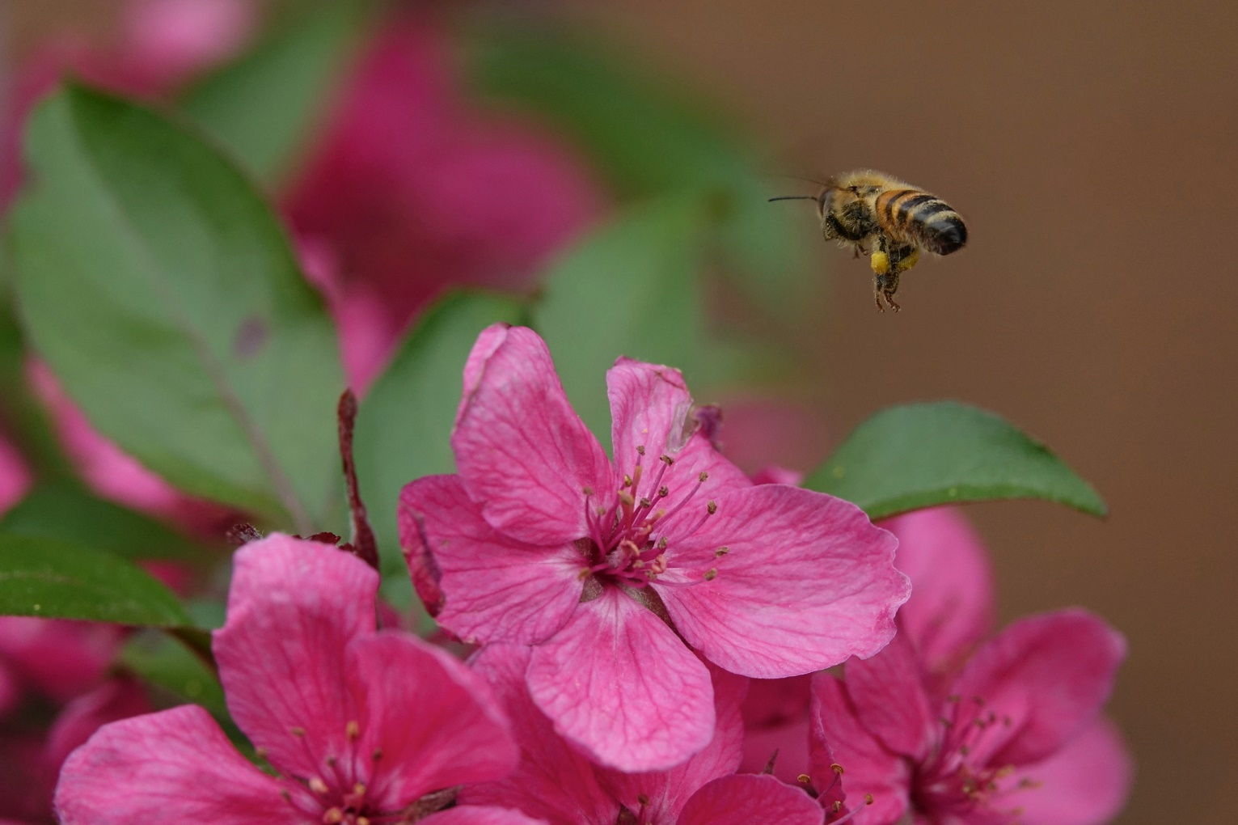
2. Bees are the most precious pollinators of plants. (PRO)
Source: Brinzan Sabina / Unsplash

Slide 13
Pollination is an ecosystem service that is key to food security and wild ecosystems.
Bees are essential for many fruit and vegetable crops, and the survival and spread of a large number of flowering plants.
Sexual reproduction of many crops and the majority of wild plants is dependent on animal pollination through insects. Among the insect pollinators, solitary and social bees provide most pollination in both managed and natural ecosystems.
There are more than 20,000 pollinating bee species in the world. No other group of insects are of more benefit to humans than bees.
The annual value of this service is estimated at US$112 billion worldwide.

Slide 14
More than one-third of the world’s crops require pollination to set seeds and fruits - crops relying on bee pollination include apple, citrus, tomato, melon, strawberry, apricot, peach, cherry, mango, grape, olive, carrot, potato, onion, pumpkin, bean, cucumber, sunflower, various nuts, a range of herbs, cotton, alfalfa and lavender.
The European honeybee (Apis mellifera) dominates crop pollination worldwide, but local native bee species also play their part.
Honeybees contribute in a balanced way to rural development efforts leading to secure and sustainable livelihoods.
It is generally known that bees are needed to pollinate our crops but it is not well known that the economic value of bee pollination is several times more the value of the world-wide production of honey.

Slide 15
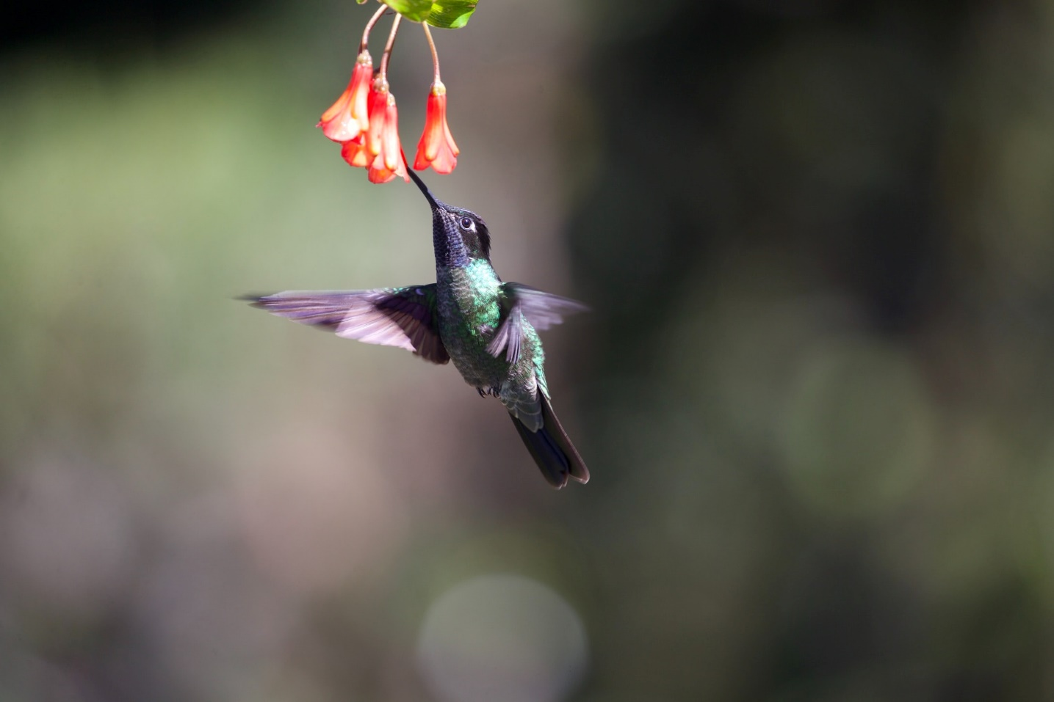
2. Bees are far from being the only valuable pollinators. (CON)
Source: James Wainscoat / Unsplash

Slide 16
There is a whole line of species whose influence on pollination is enormous, and whose survival is also in danger.
Over 920 species of birds are known to pollinate plants including those belonging to the Nectarinidae (sunbirds), Trochilidae (hummingbirds), Meliphagidae (honeyeaters), and Loridae (lories).
Birds pollinate about 5.4% of the 960 cultivated plant species for which pollinators are known and typically pollinate 5% of a region’s flora or 10% of flora if that region is an island.

Slide 17
Among mammals, bats are the major pollinators, with flower-visiting bats mostly found in two families: Pteropodidae (fruit bats), occurring mainly in Asia and Australia, and Phyllostomidae (leaf-nosed bats), distributed throughout the Neotropics.
Approximately 528 plant species in 67 families and 28 orders worldwide are pollinated by bats. Non-flying mammals such as primates, rodents, and marsupials are also known to visit at least 85 species of plants worldwide.
Bat-pollinated plants have substantial economic and social value.
In the tropics, vertebrate pollinators may play important roles not only in the regeneration and restoration of degraded natural systems but also in the long-term maintenance of both natural and agricultural systems.

Slide 18
3. Bees are threatened by extinction and should be preserved. (PRO)
Source: Bianca Ackermann / Unsplash

Slide 19
Although a number of extinctions occurred in the past, bees started going rapidly extinct at the beginning of the 21st century.
High mortality in honeybee colonies has been reported worldwide in recent decades without definitive identification of the causes. Several hypotheses have been postulated to explain these losses, but the causes have not been clearly identified.
Many factors, including internal and external pressures, exposure to various pathogens, lack of diversity of food sources, management problems, exposure to agrochemicals and a variety of stressors, act in isolation or, more often, in combination, to drive increased mortality among individual bees or managed honey bee colonies.

Slide 20
Due to the link between animal pollinators and global food security, any decline of managed honeybees and the loss of wild pollinators are of increasing concern.
Honeybee wellbeing is negatively affected by the intensive use of pesticides and fungicides in agriculture and the chronic exposure to acaricides needed to combat the parasitic mite Varroa destructor.
destruction and fragmentation of natural and semi-natural habitats as well as land use intensification in agricultural landscapes have significant negative effects on honeybees and other pollinators.
Honeybees are attacked by parasitic mites (Varroa destructor, Acarapis woodi, Tropilaelaps spp.), fungi (Nosema spp., Ascosphaera apis), bacteria (Paenibacillus larvae, Melissococcus plutonius), numerous viruses, and scavengers (from beetles and mice to bears) during any life stage.

Slide 21
3. It is not necessary to invest additional efforts in the preservation of bees since they are not endangered. (CON)
Source: Pawel Sroka / Unsplash

Slide 22
Bees are not dying out. On the contrary, the situation is quite the opposite and official data support this claim.
The number of U.S. honeybees rose in 2017 from a year earlier, and deaths of the insects attributed to a mysterious malady that’s affected hives in North America and Europe declined.
The number of commercial U.S. honeybee colonies rose 3% to 2.89 million as of April 1, 2017 compared with a year earlier.
Bees are not even close to extinction, even in the parts of the world which report the biggest losses like the USA, because the number of hives was renewed every year by multiplying existing societies.

Slide 23
If 30-40% of bee communities disappeared every year, as was reported by the media, there wouldn't be any bees left today.
The media often inaccurately and sensationally reported on the losses.
Research based on data from around the world, shows that the number of managed bee colonies worldwide increased by 45% between 1961 and 2009. At the same time, the demand for pollination of agricultural crops increased by 300% and that is what should be pointed out.
The use of neonicotinoids (a special type of pesticides), as well as the intensification of agriculture that has converted natural ecosystems into large agricultural plots, have endangered the health of bees, leading to a relative decline of their population.
While it is clear that global stocks of honey bees have increased over the last five decades, not all regions have experienced gains.

Slide 24
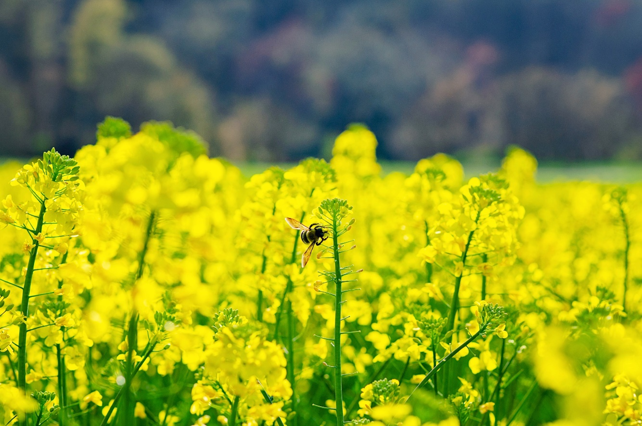
4. Bees need to be preserved because they pollinate crops key for our diet. (PRO)
Source: Joseph Northcutt

Slide 25
Would we starve without bees?
Bees have played their part either pollinating the many vegetables and fruits we eat directly, or pollinating the food for the animals that we then consume.
Honey and wax are two other important products that come courtesy of bees.
Honey bees are disappearing globally at an alarming rate due to pesticides, parasites, disease and habitat loss.
Honeybees are reported to play a vital role in enhancing the productivity levels of different crops such as fruit and nuts, vegetables, pulses, oilseeds and forage crops.
Fifty-two of the 115 leading global food commodities depend on honeybee pollination for either fruit or seed set.

Slide 26
Some honey bee-dependant commodities would have 90% yield reduction without honey bees.
In total, 22.6% of all agricultural production in the developing world, and 14.7% of agricultural production in the developed world is directly reliant on animal pollination to some extent.
When foods that indirectly benefit from pollination are included,35% of the human diet is thought to benefit from pollination.
The value of insect pollination has been estimated at US$ 212 billion (€153 billion), which represents about 9.5% of the total value of agricultural production.
Managed honey bees are ideally suited for the pollination of large monocrop plantings for several reasons.

Slide 27
The biology of honey bees also makes them well suited as commercial pollinators. Honey bees are generalists, visiting a wide range of flower types, even those they are not well suited to pollinate, such as blueberries and alfalfa.
Traveling an average of 4.5 km to forage, honey bees are able to pollinate crops over an area of 6360 ha.
A bee’s ability to communicate the location of floral resources to her nest mates makes honey bees particularly efficient pollinators.
Between 1961 and 2006, agriculture industry’s dependence on pollinators has increased by 50% and 62% in the developed and developing world, respectively.

Slide 28
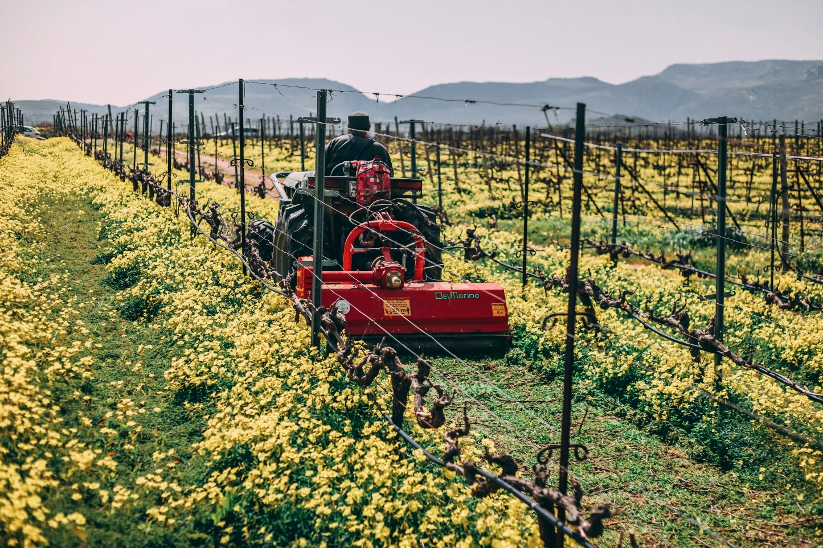
4. In no way do bees contribute to the increase in yields of plants which are most used in human diet. (CON)
Source: Lambros Lyrarakis / Unsplash

Slide 29
Back in 1992, the USDA (United States Department of Agriculture) published a guide with recommendations for a healthy diet. These recommendations were in the form of a pyramid which suggests that a person should eat more food from the bottom of the pyramid and less food and beverage from the top of the pyramid.
Why was the food pyramid created in the first place? The main reason behind the food pyramid was an expansion in the number of obese people, so its main task was to provide a nutritionally balanced diet with little energy.
The pyramid showed proportionality and diversity in each of the five food and beverage groups, which rose in horizontal layers starting from the food that should be the most common in the diet of the foundation (bread, grains, pasta and rice), then fruits and vegetables; dairy products; eggs, fish, legumes, meat and sugar.

Slide 30
The food pyramid has certainly changed since 1992, but the share of grains, bread, pasta and rice has certainly remained the same and is the most represented.
Grains increase the pH value of the body and thus have a beneficial effect on strengthening immunity.
They also have a favorable ratio of calcium and phosphorus, a high level of iron and folic acid, including essential amino acids. They are rich in fiber, which is of great importance for the preservation of the digestive and immune systems, which gets the body into the status of good homeostasis, or balance.
In order for agricultural production to be able to produce enough grain to meet food requirements, the introduction of hybrid grain varieties was of great importance.

Slide 31
The production of hybrid varieties aims to obtain grains of known characteristics, with high yields and resistant to various plant diseases.
Man is responsible for the production of grains in order to have sufficient amounts of food. Modern agricultural production follows the development of seed material, artificial fertilizers, modern mechanization (tractors, other machinery), etc. thus confirming the responsible role of the human factor.
The role of bees in the production of the most common foods in the human diet is almost negligible.
Hybrid species of plants, as well as grains, are reproduced with the help of man.
As much as bees are given priority as irreplaceable pollinators and main food producers, the facts still speak differently.
Humankind would be able to survive and food supplies would not be jeopardized.

Slide 32
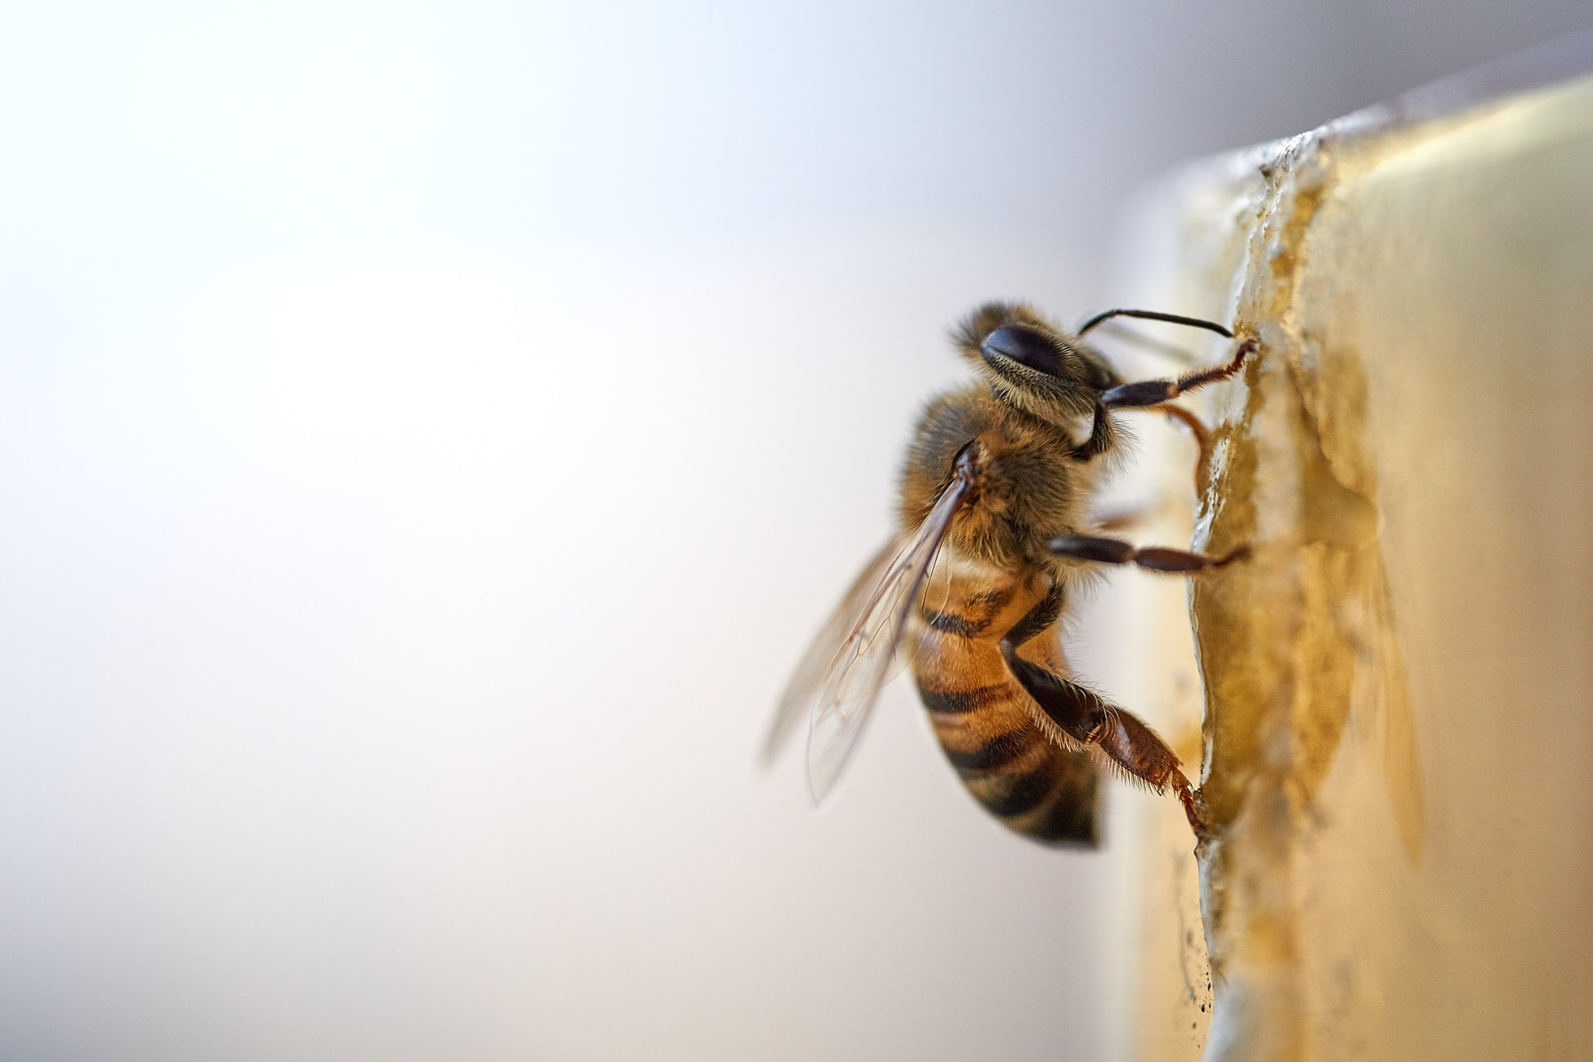
Source: Leandro Fregoni / Unsplash

Slide 33
Colony collapse disorder (CCD)
„On February 22, 2007, many Americans woke up to media reports that something was awry with their honey bees. A significant proportion of American beekeepers were complaining of unusually high rates of colony loss as their bees broke from their overwintering clusters. Loss of some colonies (say 10%) in early spring is normal and occurs every year. In 2007, however, losses were particularly heavy and widespread—beekeepers in 22 states (including Hawaii) reported the problem. Some beekeepers lost nearly all of their colonies. And the problem is not just in the United States. Many European beekeepers complain of the same problem. Moreover, beekeepers and researchers do not understand the specific causes of the losses.
Is There a Real Problem?
Were the losses in 2007 within the normal range, or is there something new afoot in the bee industry? If there is something new, what is it? Is it indicative of a general toxic overload of agricultural ecosystems, or a problem confined to the bee industry? Should beekeepers be worried? Should we be worried? The US House Agriculture Committee is sufficiently worried to be holding hearings into the matter, as well they might. Honey bees are essential pollinators: in 2000, the value of American crops pollinated by bees was estimated to be $14.6 billion.
The syndrome is mysterious in that the main symptom is simply a low number of adult bees in the hive... There are no bodies, and although there are often many disease organisms present, no outward signs of disease, pests, or parasites exist.
Here, I try to get to the bottom of the unsolved mystery of colony collapse disorder (CCD)—the official description of a syndrome in which many bee colonies died in the winter and spring of 2006–2007.“

Slide 34
What is CCD?
The syndrome is mysterious in that the main symptom is simply a low number of adult bees in the hive. (This is a bit like going to a previously well-populated hen house and finding hardly any hens.) There are no bodies, and although there are often many disease organisms present, no outward signs of disease, pests, or parasites exist. Often there is still food in the hive, and immature bees (brood) are present. The cause of the loss of bees seems to be the sudden early death, in the field, of large numbers of adult workers. Curiously, the dead colonies tend to be left alone by the two cleptoparasites that normally infest dead honey bee colonies: the wax moth Gallaria mellonella and the small hive beetle Aethina tumida. Could this be due to some toxic residue in the dead colonies? Perhaps this was a contributing factor, but more likely the time of year meant that there were few cleptoparasites about—their abundance is seasonal.
Were the Losses Unusual?
Some winter losses are normal, and because the proportion of colonies dying varies enormously from year to year, it is difficult to say when a crisis is occurring and when losses are part of the normal continuum. What is clear is that about one year in ten, apiarists suffer unusually heavy colony losses. This has been going on for a long time. In Ireland, there was a “great mortality of bees” in 950, and again in 992 and 1443 [3]. One of the most famous events was in the spring of 1906, when most beekeepers on the Isle of Wight (United Kingdom) lost all of their colonies [4]. American beekeepers also suffer heavy losses periodically. In 1903, in the Cache valley of Utah, 2000 colonies were lost to a mysterious “disappearing disease” following a “hard winter and cold spring”. More recently, there was an incident in 1995 in which Pennsylvania beekeepers lost 53% of colonies .
Often terms such as “disappearing disease” or “spring dwindling” are used to describe the syndrome in which large numbers of colonies die in spring due to a lack of adult bees [7,8,9]. However in 2007, some beekeepers experienced 80–100% losses. This is certainly the extreme end of a continuum, so perhaps there is indeed some new factor in play.
Benjamin P Oldroyd, What's Killing American Honey Bees?, PLoS Biol. 2007 Jun; 5(6): e168

Slide 35
Source: Shelby Cohron / Unsplash

Slide 36
Einstein & Bees
„A story in the influential German newspaper Der Süddeutsche Zeitung, Germany’s largest national daily paper with a circulation over 600,000, provided a pithy assessment of the gravity of the situation from the undisputed scientific genius Albert Einstein: “Wenn die Biene von der Erde verschwindet, dann hat der Mensch nur noch 4 Jahre zu leben,” or, loosely translated, “If bees disappear from the earth, humans will cease to exist within four years.” I came across this story not because I’m in the habit of perusing German periodicals but rather because I was interviewed for the story and the journalist sent me a copy. I was quoted in the story as saying, among other things, “Wenn Sie einen Hamburger essen ... dann verdanken Sie das indirekt den Bienen,” which is, roughly translated, “Whenever you eat a hamburger, you have a bee indirectly to thank.” I’m sure my high-school German teacher would have been pleased by the grammatical correctness, but, as pithy or quotable phrases go, it certainly falls far short of the Einstein quotation, in either language. As for that Einstein quotation, it certainly sounded authoritative and credible, particularly in German. Even in translation, however, it didn’t sound familiar.“

Slide 37
„As it turns out, I was certainly not the only one who couldn’t find the quotation in any of Einstein’s writings. Before I stumbled across it, the Web site Snopes.com, devoted to quashing Internet rumors, had already dispensed with questions surrounding its authenticity (April 21, 2007), reporting that at least one Einstein biographer, Walter Isaacson, and the author of The New Quotable Einstein, Alice Calaprice, had never come across it in their extensive research. According to the site, the quotation appears not to have existed before 1994, almost a half-century after Einstein died. So, if Einstein did indeed say it, he must have said it at a séance through a medium. The quotation appeared to have materialized for the first time in a pamphlet published by the National Union of French Apiculture in the midst of concerns throughout Europe about unfair price competition from cheap honey imports and looming tariff reductions predicted to exacerbate the problem. In the pamphlet, beekeepers warned of the dire consequences of a collapse of their industry, invoking Einstein in predicting that honey dumping by China could well mean the end of human civilization on earth.“
May R. Berenbaum, The Earwig’s Tail: a modern bestiary of multi-legged legends, Harvard University Press, 2009.

Slide 38
Source: Annie Spratt / Unsplash

Slide 39
Video materials
Ivan Umeljić / ODYSSEY Debate: The future of humanity depends on the conservation of honeybees: https://youtu.be/Q2V_jiRUFcg
Dennis vanEngelsdorp: Where have the bees gone?
https://www.youtube.com/watch?v=3GXlvP4kLHg
Marla Spivak: Why bees are disappearing
https://www.youtube.com/watch?v=dY7iATJVCso
Tom Seeley: Darwinian beekeeping
https://www.cornell.edu/video/professor-tom-seeley-explains-darwinian-beekeeping
Louie Schwartzberg: The hidden beauty of pollination
https://www.youtube.com/watch?v=eqsXc_aefKI

