Slide 1
Deabate
The best way to preserve an ecosystem is by rewilding
Topic: Environmental preservation

Slide 2
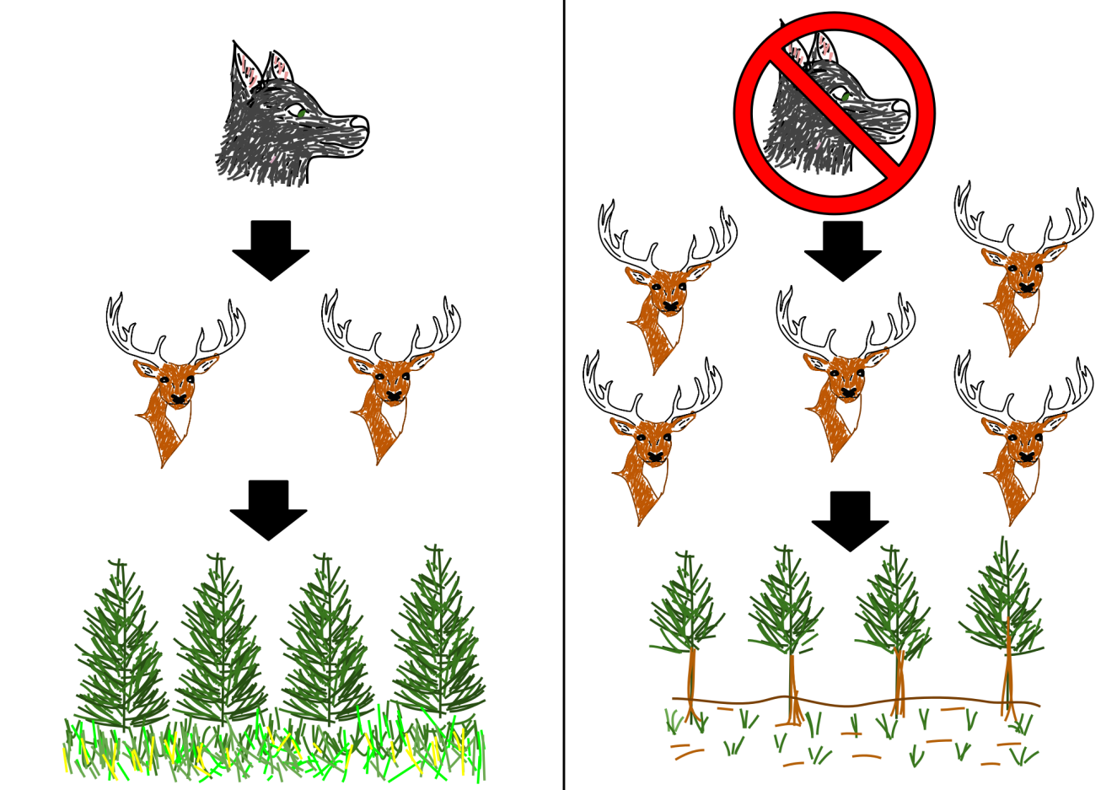
Basic terms
Trophic cascade – Predators influence the abundance and behavior of prey. Prey abundance can be reduced if there are predators nearby, or prey can hide or move further. When the influence of a predator on its prey is so large that it reduces the trophic level at another level of the food chain (which affects the density of prey, in our case – vegetation), this is called a trophic cascade.
Megafauna – Megafauna refers to large terrestrial mammals, larger than humans and not domesticated. The term refers especially to Pleistocene megafauna or extinct terrestrial animals, such as mammoths, most often larger than their modern relatives. As for the extant animals, megafauna includes elephants, giraffes, hippos, rhinos, cattle, etc. According to their diet, species of megafauna can be grouped into three categories: megaherbivores (e.g. elephants), megacarnivores (e.g. lions), megaomnivores (e.g. bears).
Source: Wikimedia Commons

Slide 3
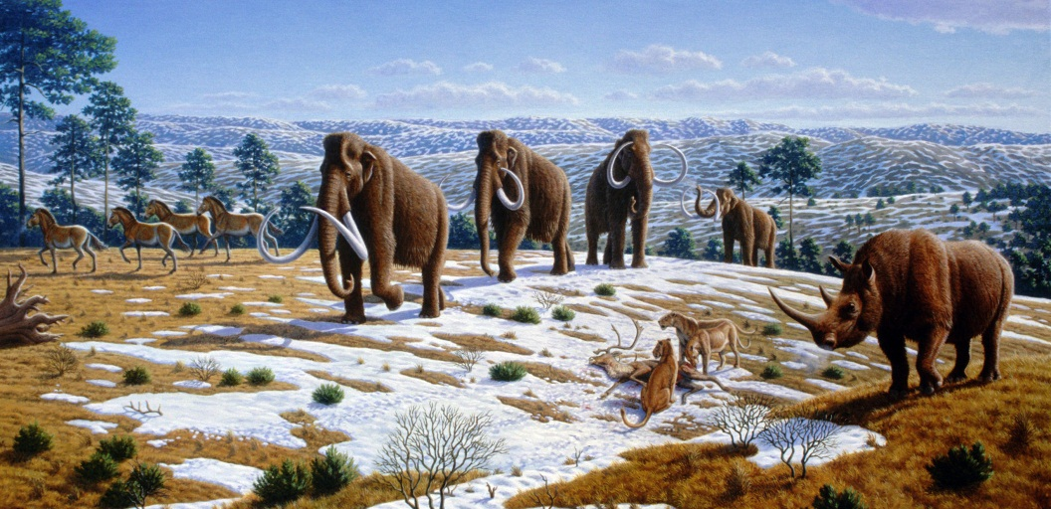
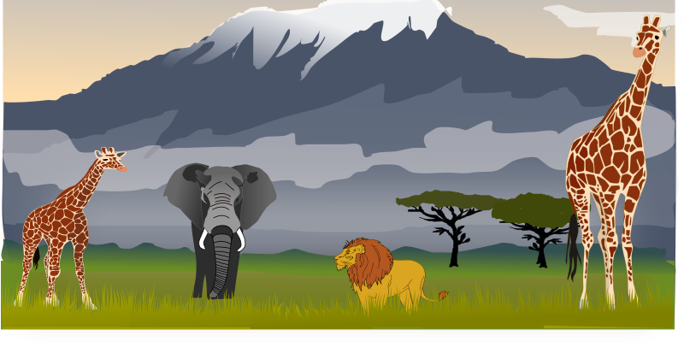
The Pleistocene – The Pleistocene epoch is part of the geological chronology. It started 1.81 million years ago and ended 11,550 years ago. The mass extinction of large mammals (megafauna), which included mammoths, mastodonts, tiger sabers, gliptodonts and land sloths, started at the end of the Pleistocene and continued into the Holocene.
Rewilding – It is a novel approach to ecological restoration, the aim of which is to restore natural processes in ecosystems. This most often involves the resettlement (reintroduction) of large wild species into endangered ecosystems, and in the case of species that were extinct in the past, the introduction of their closest phylogenetic relatives. Many environmentalists agree that most of the world's ecosystems last functioned independently of the influence of modern humans before the so-called Pleistocene extinction − around 50,000-7,000 years ago. This is why the Pleistocene ecosystems, and especially those of the late Pleistocene period, are considered to be the starting point for how ecosystems function without the influence of man, which is also the main measure of the ecological concept of rewilding, which should consolidate, revitalize and restore ecosystems to their initial state.
Source: Wikimedia Commons
Source: Openclipart

Slide 4
Introductory questions
What would happen if agricultural land which had been cultivated regularly for years would be left to its own devices? From the point of view of preserving biodiversity, would this be positive? Would it be acceptable for the local community and decision makers?
When should man intervene to prevent the extinction of species in the wilderness? What measures could be taken?
Is rewilding a sensible and sustainable goal? How can we determine and test this?
How would you feel if you knew that there are wolves in the area where you live?

Slide 5
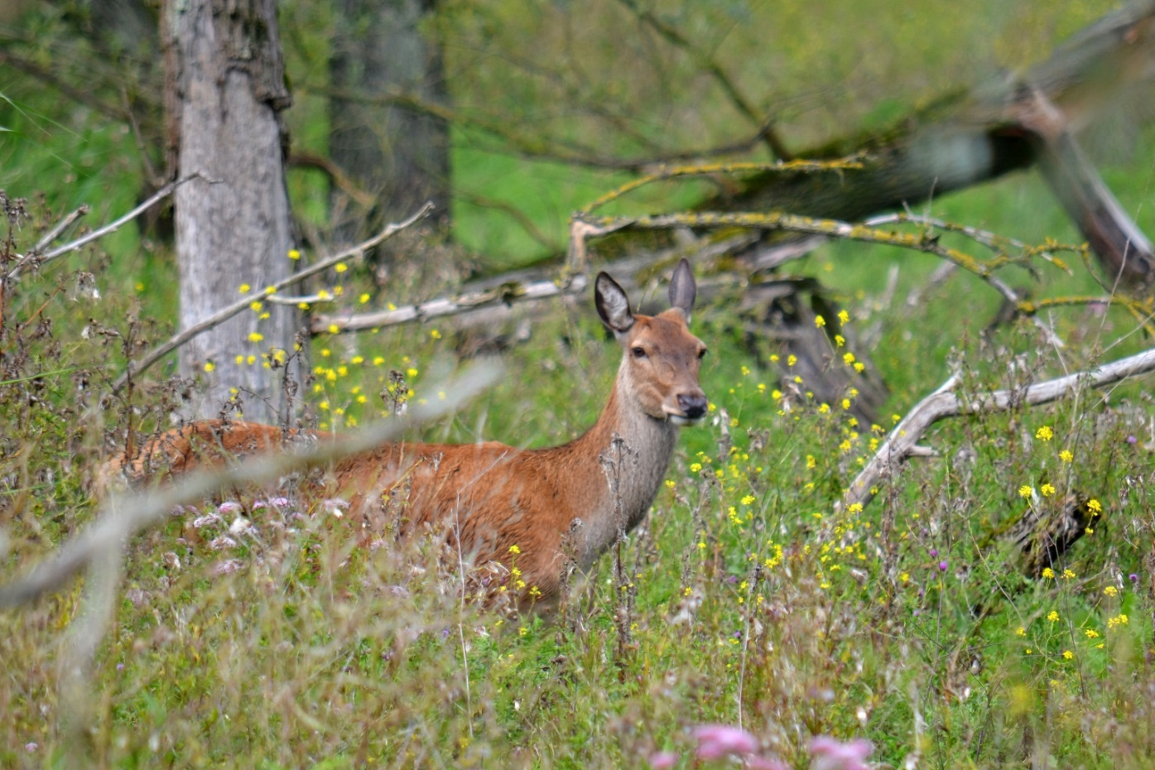
RESOLUTION: The best way to preserve an ecosystem is by rewilding.
Source: Flickr

Slide 6
PRO
CON
1. Today's species have evolved when the Earth was dominated by megafauna (large predators and herbivores) extinct mainly due to direct or indirect human influence. Therefore, it is necessary to introduce megafauna into the endangered ecosystems and renew the connections and functions that existed before the detrimental human action.
2. Rewilding is a collective name for several ecological approaches offering a wide range of solutions for environmental problems we are faced with today.
3. Every rewilding project can have a positive influence on local life habits and people's wellbeing.
4. Not only is it a novel and promising environmental concept, rewilding is somewhat of a narrative of hope.
1. Rewilding as a project is destined to fail. From the Pleistocene until today, ecosystems have changed immensely, and species have had enough time to adapt to the conditions with no megafauna, which disables plans for reviving past ecosystems.
2. An insufficiently definite and imprecise definition brings confusion and contradicted views about the main goals and means of rewilding.
3. Rewilding can have many unwanted consequences for people; the relationship between humans and the wilderness has always been characterized by a series of paradoxes.
4. Rewidling is the new Pandora's box of environmental preservation and can harm biodiversity.

Slide 7
1. Today's species have evolved when the Earth was dominated by megafauna extinct mainly due to direct or indirect human influence, it is necessary to introduce megafauna into the endangered ecosystems and renew the connections and functions that existed before the detrimental human action. (PRO)
Source: Wikipedia

Slide 8
Many environmentalists agree that most of the world's ecosystems functioned independently of the influence of modern man before the so-called Pleistocene extinction - which took place around 50,000-7,000 years ago.
The extinction of megafauna was caused by humans, or mores specifically uncontrolled overkill, as well as climate change - or, most likely, a combination of both.
Today's "power distribution" of species evolved in a period when ecosystems were rich in megafauna and it is adapted to them.
This is why it is necessary to (re)introduce megafauna into endangered ecosystems and thus restore the natural relationships and functions that existed in them before the adverse influence of man.

Slide 9
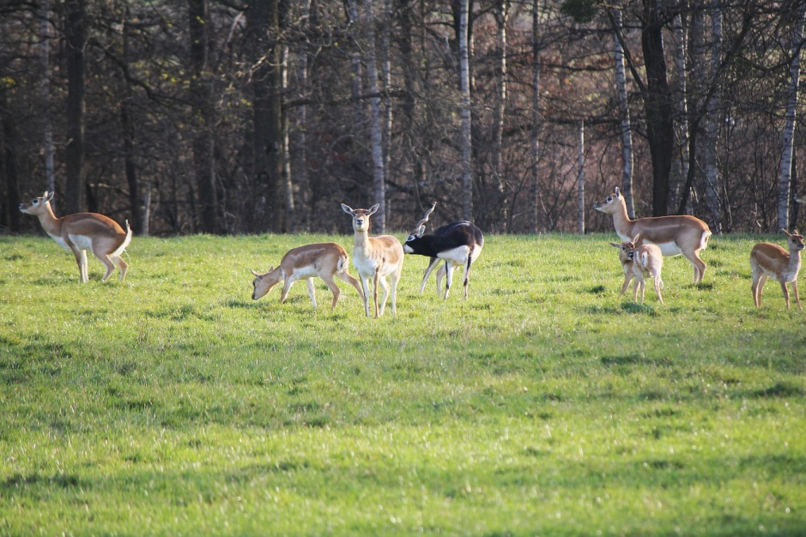
1. Rewilding as a project is destined to fail. From the Pleistocene until today, ecosystems have changed immensely, and species have had enough time to adapt to the conditions with no megafauna, which disables plans for reviving past ecosystems. (CON)
Source: Needpix

Slide 10
The global climate has changed and many species have survived, finding their ecological balance with other species, potentially stopping any plans to restore past ecosystems.
Therefore, introduced species cannot respond properly to today's environment since they are not adapted to it.
It is possible that the introduced species are so successful that they can disrupt existing food chains and start pushing out native species by taking over their resources and territories, which would ultimately lead to a decrease in biodiversity.
Newcomers can also bring along exotic parasites and diseases, which would have unforeseeable negative effects on existing species.

Slide 11
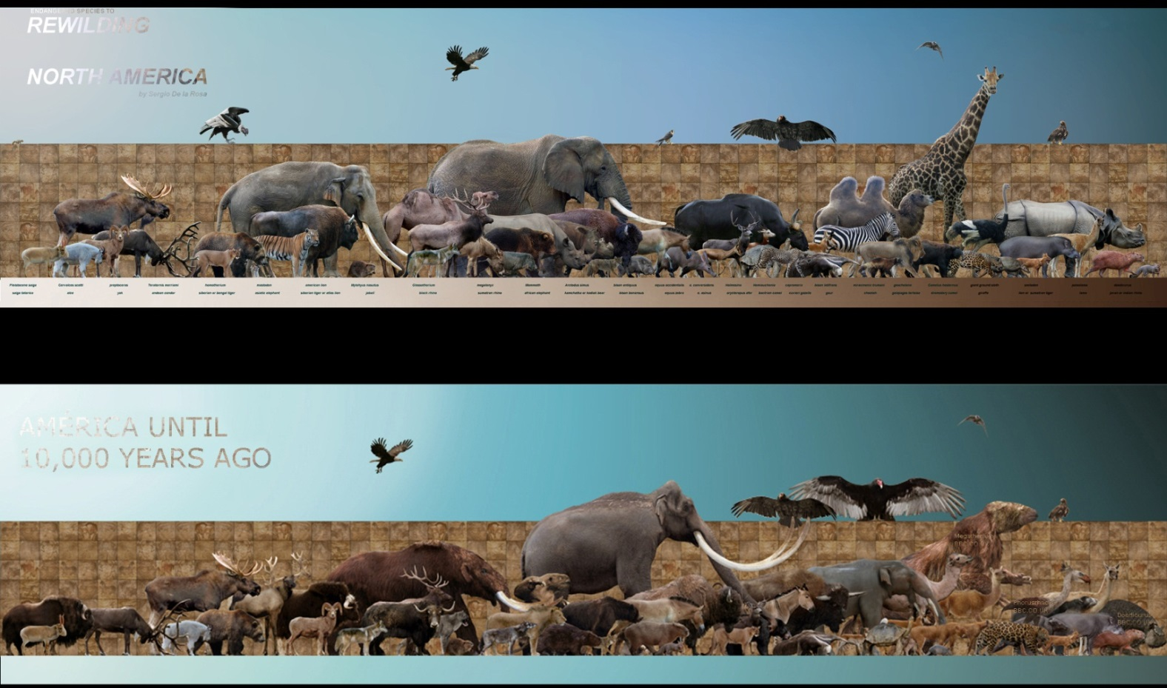
2. Rewilding is a collective name for a number of environmental approaches that offer a range of solutions to the environmental problems we are faced with today. (PRO)
Source: Wikipedia

Slide 12
The term rewilding came out of the collaboration between conservation biologist Michael Soule and environmental activist David Foreman in the late 1980s, which led to the creation of The Wildlands Project in North America.
In this version of rewilding, the focus was on connecting the area and releasing keystone species into the wild - most important of which were wolves.
The reintroduction of wolves into Yellowstone is cited as the most prominent practical example of this approach - wolves have influenced the behavior and density of elk populations (decreased the population) and indirectly stimulated the growth and development of favorite elk prey, young aspen shoots, thus dramatically affecting the plant community structure in this vast area.
The European approach to rewilding is mainly focused on re-establishing large herbivores communities (or their closest taxonomic relatives) - cattle, horses, feral pigs, beaver and bison - who graze and brush plant vegetation, this way restoring or creating ecosystems.

Slide 13
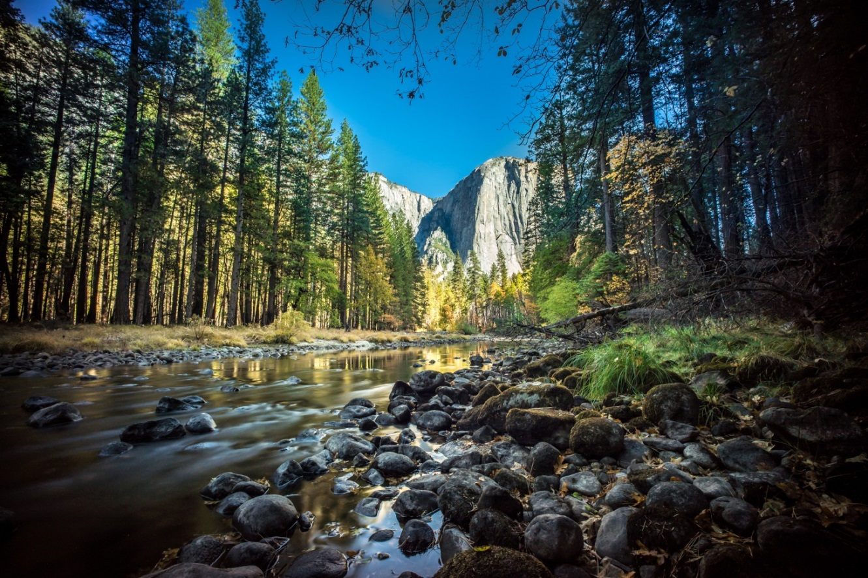
2. An insufficiently definite and imprecise definition brings confusion and contradicted views about the main goals and means of rewilding. (CON)
Source: Flickr

Slide 14
There is no consensus on what rewilding is and what it is not, which puts us at risk because we cannot clearly understand the goals of rewilding, nor can we clearly see the benefits it brings or foresee its potentially adverse consequences.
Ecological systems and relationships within them are dynamic, and species in ecosystems are in an ongoing process of evolution, which makes it difficult to predict with certainty the consequences of introducing new species.
There are failed examples of introductions or reintroductions and examples of when introductions or reintroductions caused unexpected negative consequence.
We do not know to what extent an ecosystem should to be restored and this issue is crucial for determining the goals of individual rewilding projects.

Slide 15
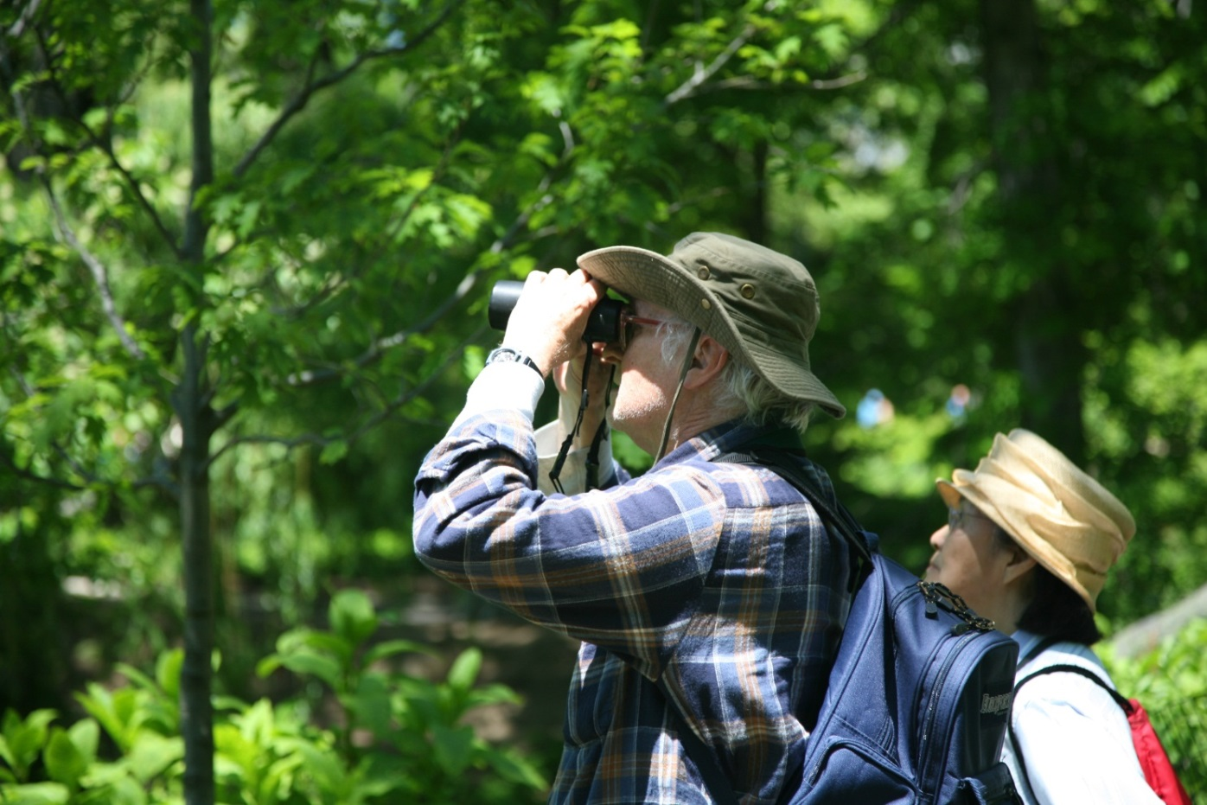
3. Every rewilding project can have a positive influence on local life habits and people's wellbeing. (PRO)
Source: Wikimedia Commons

Slide 16
An increasing number of scientific studies shows that exposure to green and natural environments and spaces can reduce stress levels, promote positive emotions and cognitive functions, stimulate physical activity and promote social cohesion in humans.
Rewilding can encourage and motivate activities which are inextricably linked to nature such as, for example, bird watching.
The economic benefit is that it opens up space for a nature-based economy and alternative sources of income based on intangible contributions to nature.
Rewilding encourages thinking about different regulatory measures and solutions based on nature, which concern climate, air quality, etc.

Slide 17
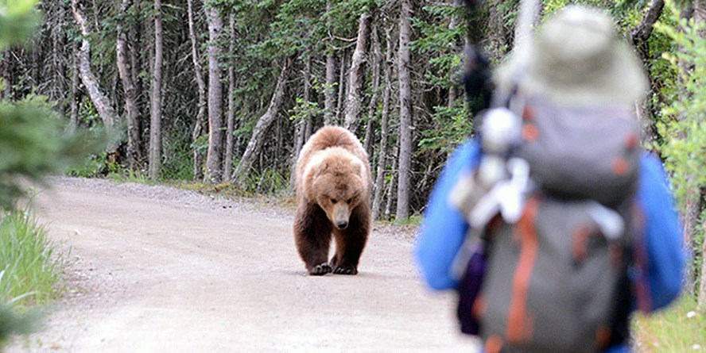
3. Rewilding can have many undesired consequences for people; the relationship between humans and the wilderness has always been characterized by a series of paradoxes. (CON)
Source: National Park Service

Slide 18
Conflicts between people and wild animals - for example, because herbivores destroyed crops or because large predators killed cattle - are becoming more frequent and more serious in those areas where animals have been reintroduced.
Rewilding can cause controversy and resistance in humans if it leads to significant changes in areas rich in tradition and cultural and natural heritage.
It is very difficult to convince people that there is nothing problematic about living near elephants or lions, which can harm their crops, pets, and even humans themselves.
Since the Pleistocene rewilding would be too expensive, many suggest it is better to invest money in the preservation of the megafauna in its natural area of distribution.

Slide 19
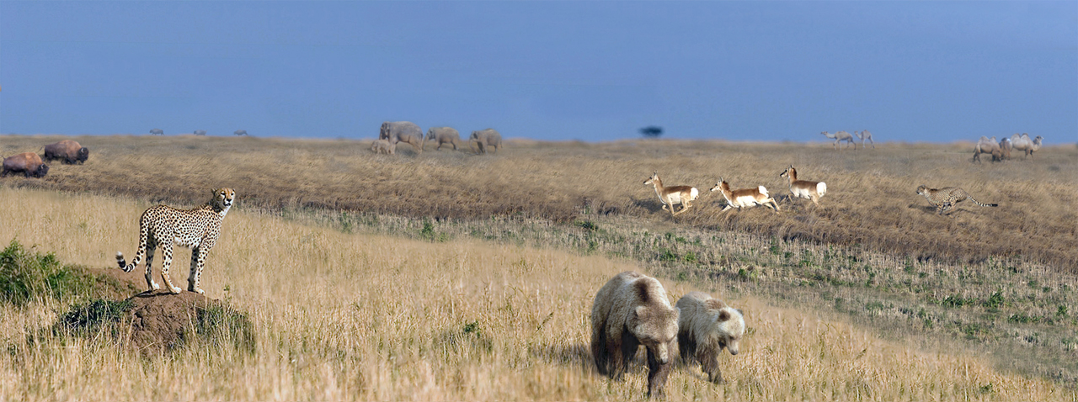
4. Not only is it a novel and promising environmental concept, rewilding is somewhat of a narrative of hope. (PRO)
Source: Wikipedia

Slide 20
According to the Living Planet Index, between 1970 and 2012, fish, mammal, and bird populations declined by 58%.
In addition to being a new and promising environmental concept, rewilding is in itself somewhat of a narrative of hope, and is it expected to stop or at least slow down defaunation and prevent further disruption of biodiversity.
The United Nations General Assembly recently made the next decade 2021-2030 "a decade of ecosystems restoration“, and it is rewilding that can provide new approaches to ecosystems restoration.

Slide 21
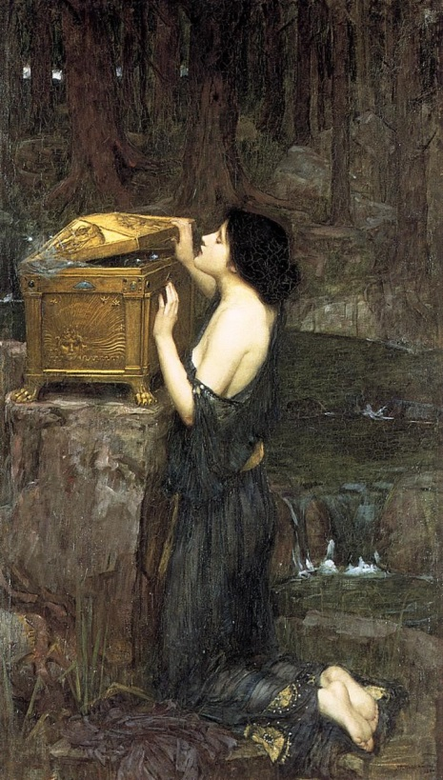
4. Rewidling is "the new Pandora's box of environmental preservation" and can harm biodiversity. (CON)
Source: Wikimedia Commons

Slide 22
Many species have taken on new and unpredictable ecological roles and niches after inhabiting new areas, which often jeopardized the existence of local native species.
Around half of the introduced vertebrate species became pests!
An age-old ecological process cannot be replicated onto today's state.
We have little reason to believe that it makes sense to inhabit many large animals and to expect that this would start processes similar to those of the late Pleistocene.

Slide 23
STORY (1): Trafalgar Square
Below the Trafalgar Square in London, hippopotamus bones, and bones of ancestors of straight-tusked elephants, giant deer, giant aurochs and lions were.
These lions were larger than those now living in Africa and survived in Britain until 11,000 years ago.
The same place was inhabited by spotted hyenas, which still live in Africa.
Source: Flickr

Slide 24
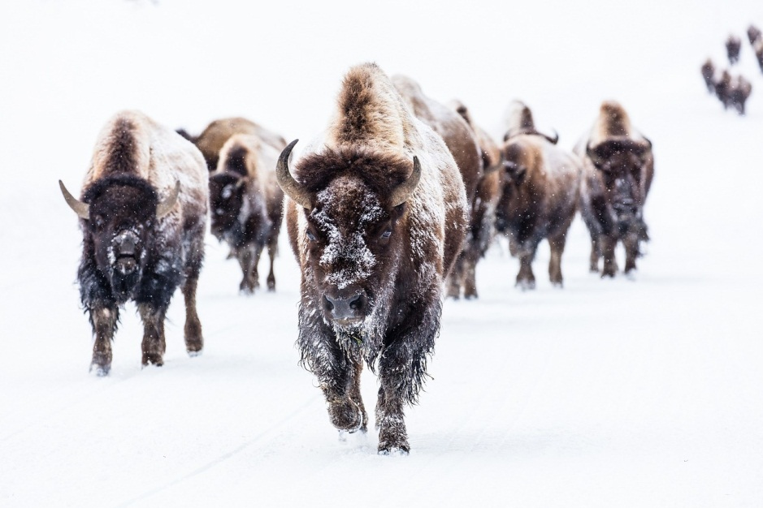
STORY (2): The Pleistocene Park In Siberia
Pleistocene Park is a major initiative that includes an attempt to replicate the Pleistocene state and restore the mammoth ecosystem.
It consists of an enclosed area of 16,000 hectares that is home to five major herbivore species: bison, musk ox, moose, horses, and reindeer
There is an ultimate goal of acclimatizing Siberian tigers should the herbivores become sufficiently abundant.
Source: Needpix

Slide 25
Ivan Umeljić / ODYSSEY debate: The best way to preserve an ecosystem is by rewilding https://youtu.be/pSkUaLb8emY George Monbiot: For more wonder, rewild the world https://www.ted.com/talks/george_monbiot_for_more_wonder_rewild_the_world?language=en George Monbiot: An animated guide to rewilding made simple https://www.youtube.com/watch?v=X-qquAUA1TI George Monbiot: From the top of the food chain down: Rewilding our world https://www.youtube.com/watch?v=t3I9gDocYdk Why humans run the world | Yuval Noah Harari https://www.youtube.com/watch?v=nzj7Wg4DAbs
Video material:

